Slide 1
Arts and Humanities Faculty Research and Creative Inquiry Showcase and Reception
The Faculty Research and Creative Inquiry Showcase celebrates recipients of Arts and Humanities Course Release and Large Grants and features the results of their work through flash talks and visual displays

Slide 2
Twelve Arts and Humanities units represented at today’s showcase!
Comparative Studies
Dance
East Asian Languages and Literatures
English
French and Italian
Germanic Languages and Literatures
History
Linguistics
Music
Near Eastern and South Asian Languages and Cultures
Slavic and East European Languages and Cultures
Spanish and Portuguese

Slide 3
David Hedgecoth Associate Professor School of Music

Slide 4
CCR
AU24
Academic and Artistic Residencies
Federal University of Paraná
Federal University of Pernambuco
Masterclasses
Graduate collaborative research group
Social Projects
SP25
Host faculty and graduate student from UFPA
Masterclasses
Graduate collaborative research group
Social Projects
David Hedgecoth, School of Music

Slide 5
Philip Tuxbury-Gleissner Assistant Professor Slavic and East European Languages and Cultures

Slide 6
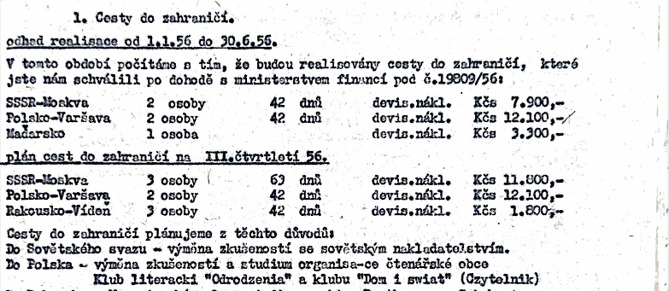
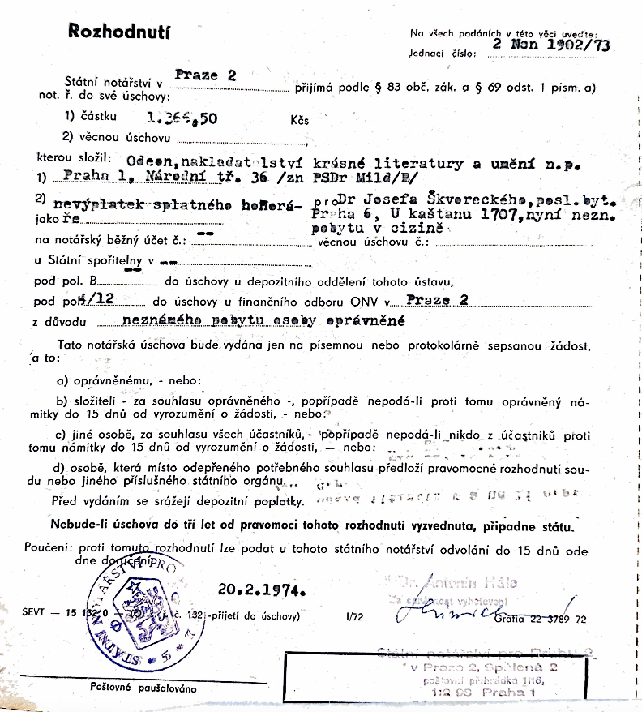
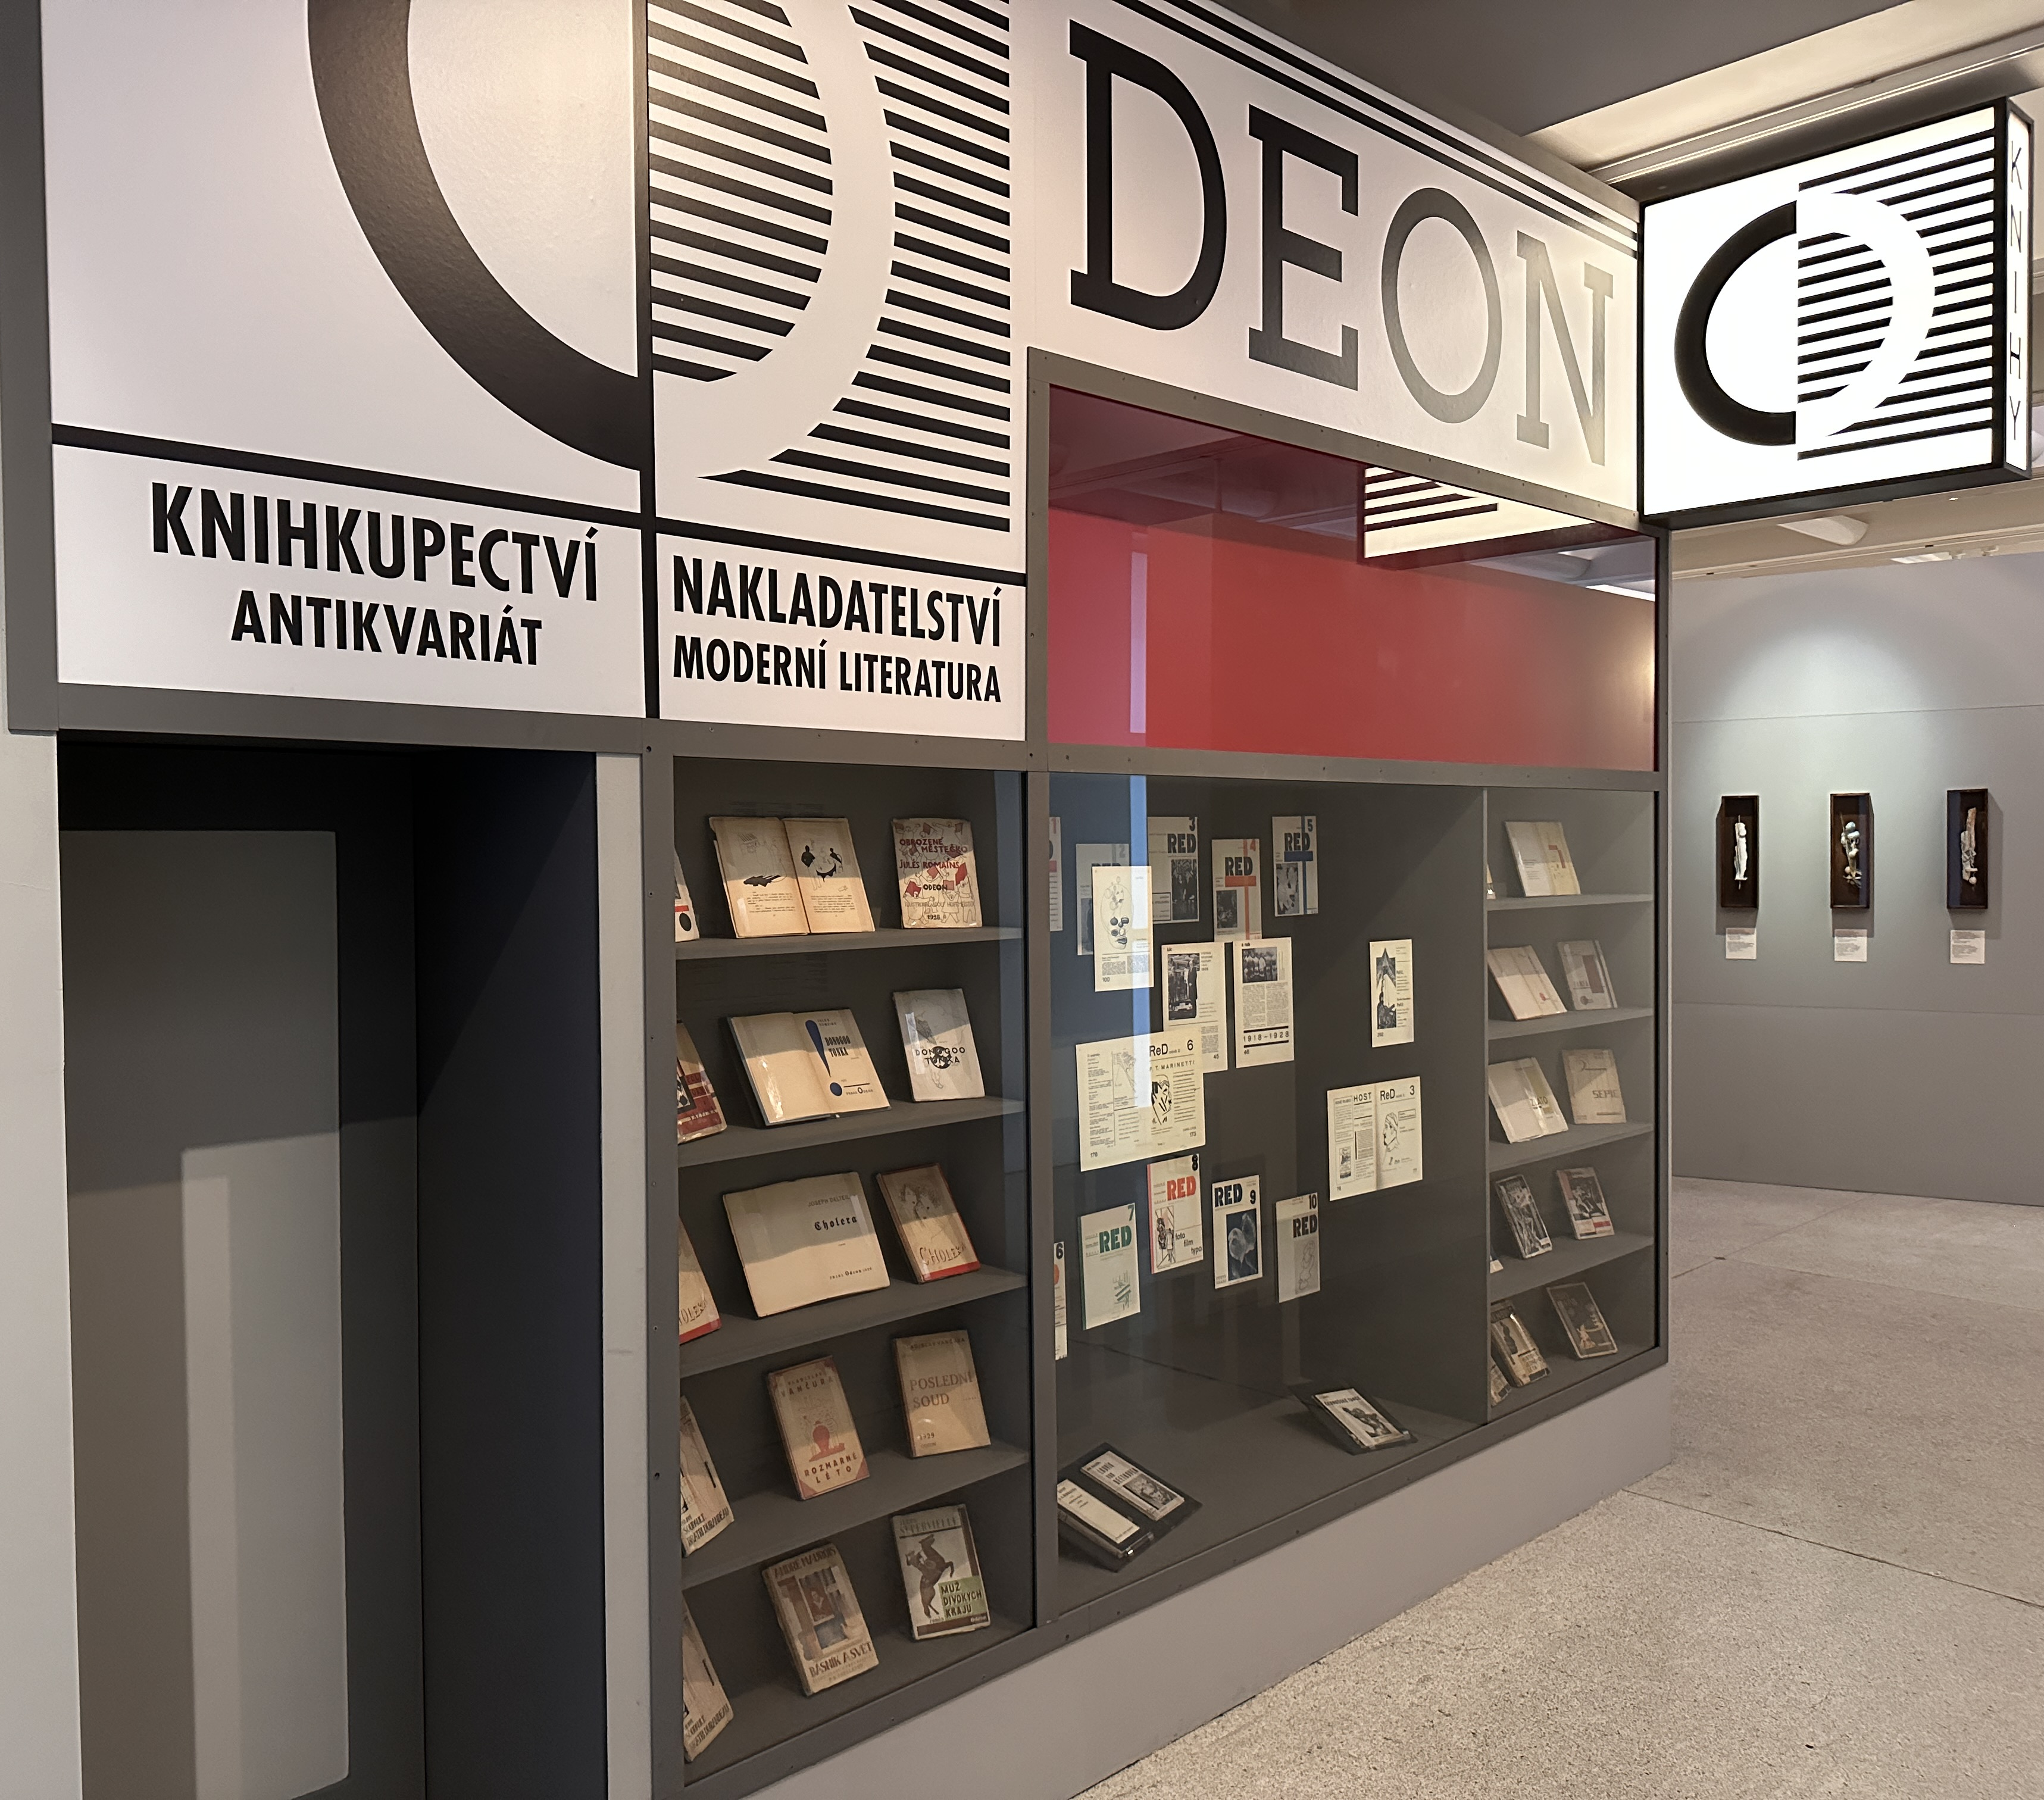
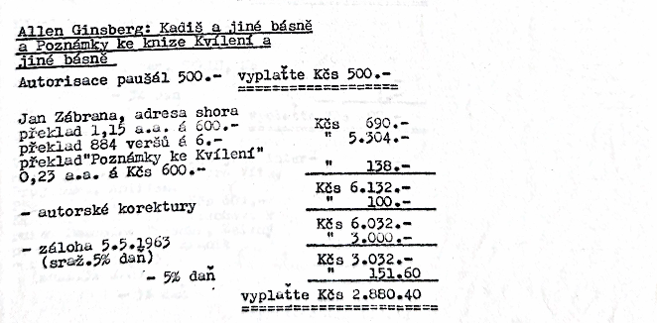
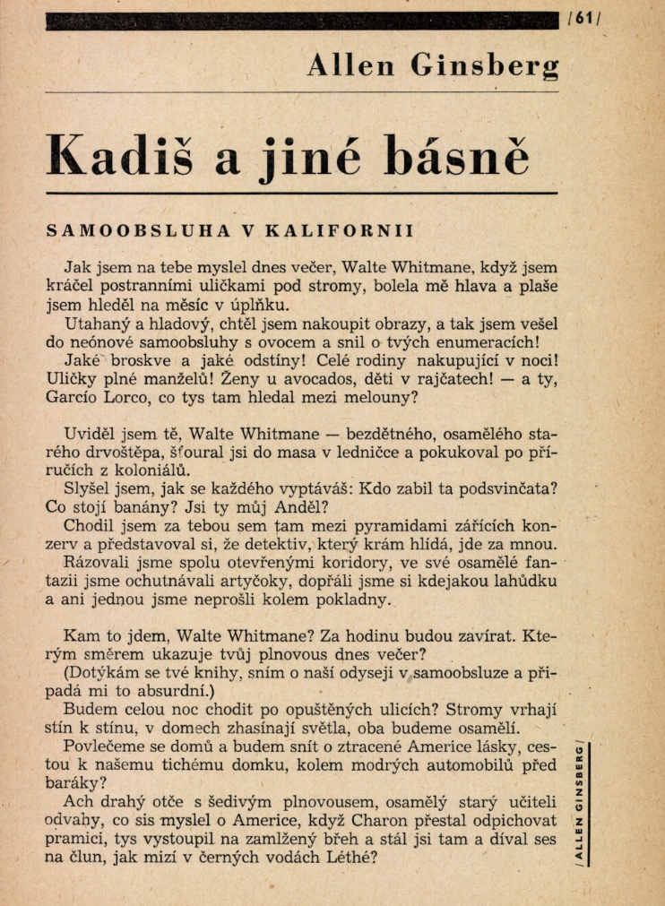
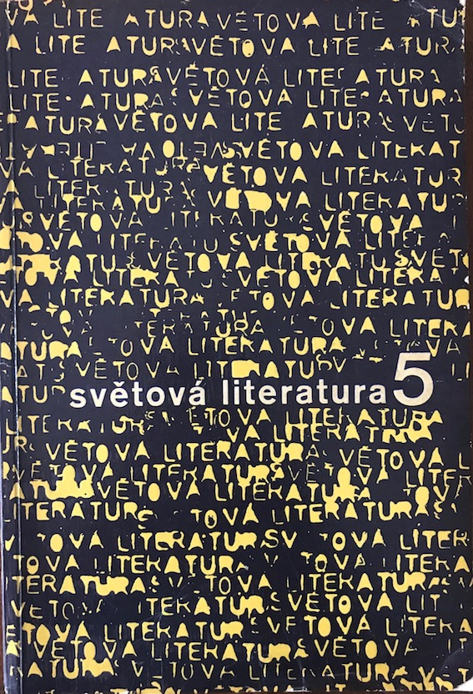
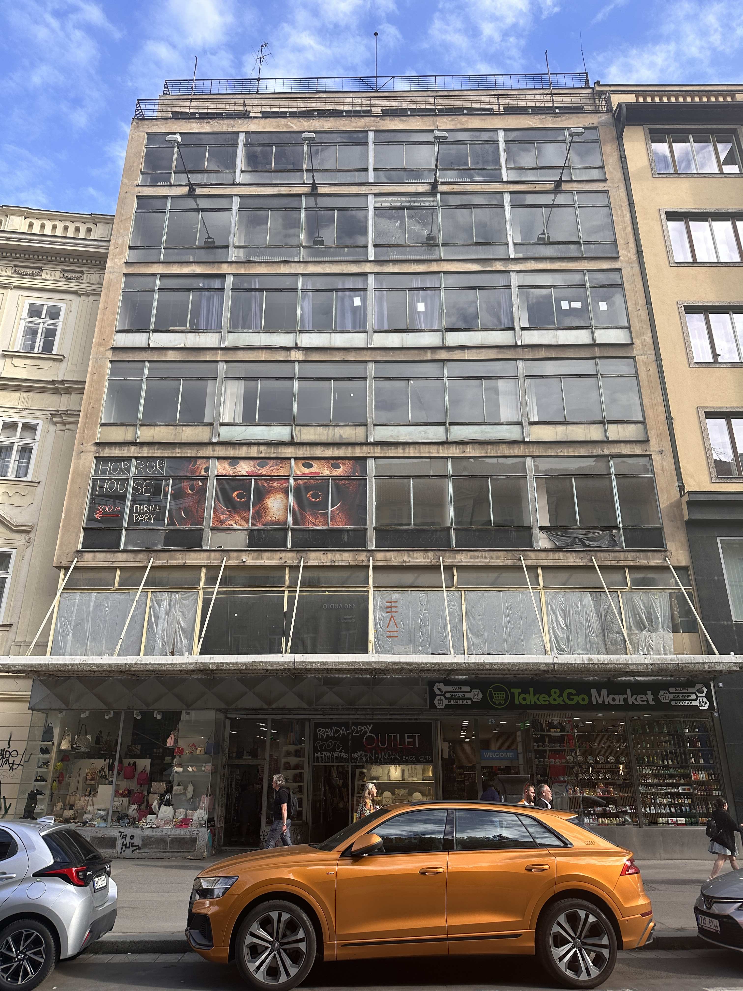
The Czechoslovak State Publisher of Belles-Lettres and Art
A History of Socialist Culture through the Lens of Literary Publishing
Philip Tuxbury-Gleissner, SEELC
Research at Czech National Archive
in preparation of monograph.

Slide 7
Theodora Dragostinova Professor Department of History

Slide 8
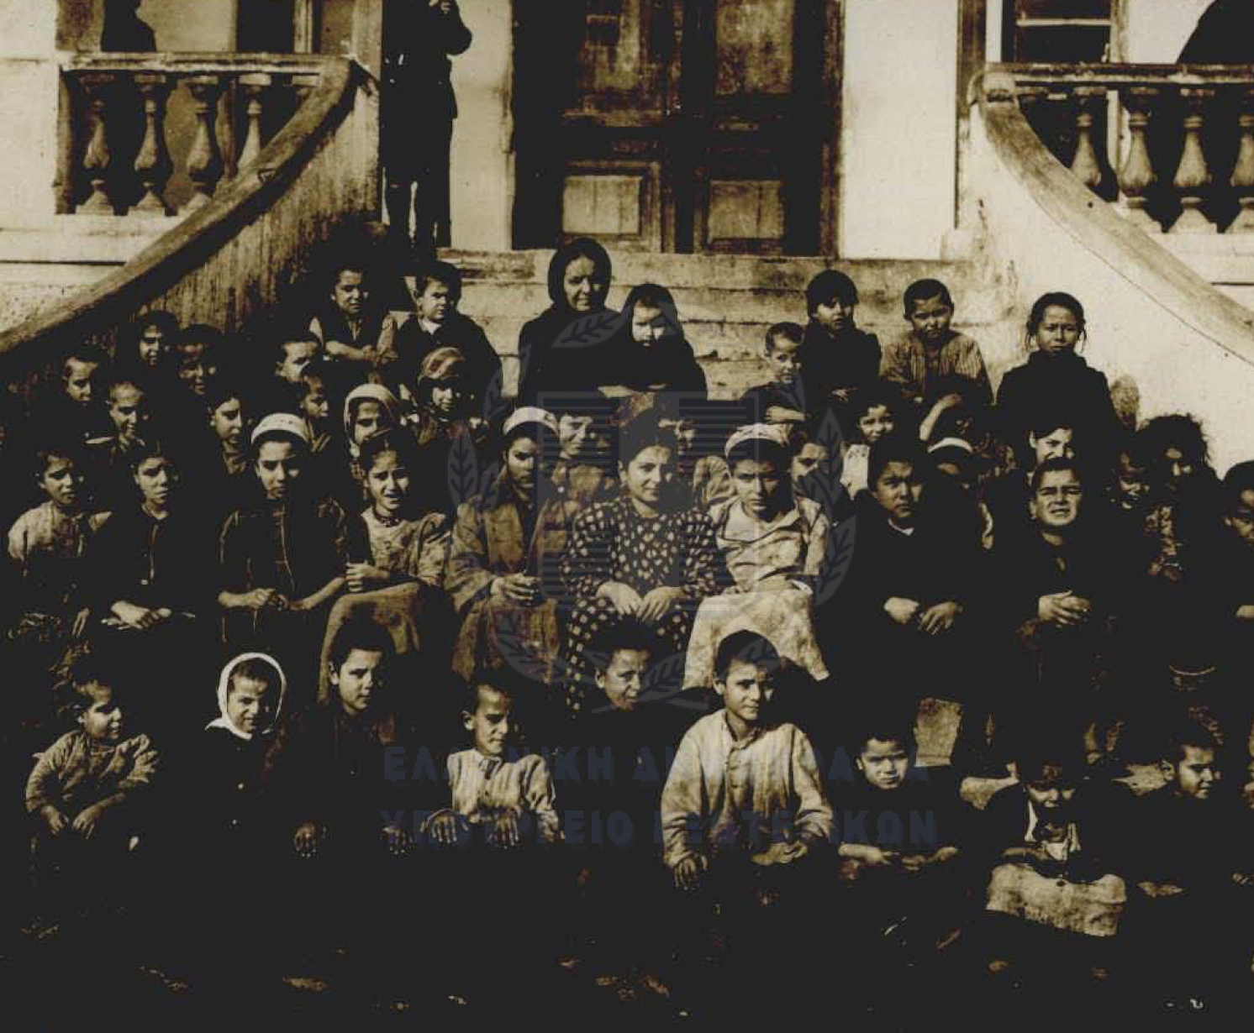
Spoils of war: the repatriation of children in the post-1918 Balkans Theodora dragostinova
The research: 1,000 children in the Balkan borderlands
The question: How to tell fact from fiction and propaganda?
The methodology: Fragmented archives into “archival whispers”
The context: Uncertainty as a postwar condition for both nations and families
The repatriation of children: Who is a child? Why forced repatriation?
The goal: Journal article cluster for American Historical Review’s History Lab on “Im/Mobilities at the End of Empire”

Slide 9
Johanna Sellman Associate Professor Near Eastern and South Asian Languages and cultures

Slide 10
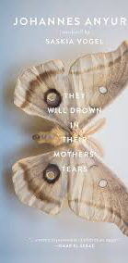
Moth Journeys and Butterfly Effects: Longing and Postmigrant Intertextuality in Johannes Anyuru’s De kommer att drunkna i sina mödrars tårar Johanna Sellman, Associate Professor Department of Near Eastern and South Asian Languages and Cultures

Slide 11
John Grinstead Chair Spanish and Portuguese

Slide 12
Developmental Semantics in Imbabura Kichwa John Grinstead & Santiago Gualapuro Gualapuro Department of Spanish & Portuguese
Do elementary-school aged child-speakers of Imbabura Kichwa in Ecuador have similar, “some, but not all” interpretations of sentences with the quantifier wakin (“some”), as has been reported in other languages?
Grice (1975) and Horn (1989) claim that quantifier sits on a pragmatic scale in the lexicon and that using “some” negates the stronger quantifiers on the scale, including “all”, yielding the “some, but not all” scalar implicature interpretation.
Is this true in less-commonly-studied languages, such as Imbabura Kichwa?
A video is shown in which 4 of 4 children go up the stairs in a house, and participants hear the sentence, “Some children went upstairs.” in Kichwa.
Adults say “No, they all went upstairs.”
Participants (n = 49) appear more adult-like as they age, and 8-year-olds appear adult-like, as in other languages.
Data analysis is still in progress, but in our current small sample (n = 23) of spontaneous production data, morphosyntax (MLUw) and lexicon (NDW) correlate (r = .621, p = .002), as in other languages.
Will overall size of the lexicon predict sentence interpretations, as it does in child Spanish? Hopefully, ongoing data analysis will answer this question.

Slide 13
Marc Ainger Associate Professor School of Music

Slide 15
Christopher Highley Professor Dept. of English Director of the Center for Medieval and renaissance Studies

Slide 18
Ori yehudai Associate professor History Schottenstein chair in Israel Studies

Slide 19
May Mergenthaler Associate Professor Germanic Languages and Literatures

Slide 20
Book project by May Mergenthaler Poetology of Light: The Emergence of the Lyric in the 18th century
Thesis: Light is a foundational figure and aesthetic concept of lyric poetry, in particular German lyric poetry, emerging in the 18th century.
Poetology refes to the theory of poetry that is implicitly or explicitly stated in a poem.
Three articles from three chapters have been published in peer-reviewed journals in 2019, 2021, and 2023.
Work for this semester, to be completed by Dec. 31, 2024: Introduction & Theoretical Framework

Slide 21
Inspiration: Hans Blumenberg‘s Metaphorology of Light
Hans Blumenberg’s metaphorology of light that is a foundation for his planned but never completed metaphorology of philosophy. For Blumenberg, light is the basic or absolute metaphor for the foundational concept of Western metaphysics: the concept of being. Being, B. argues, cannot be grasped as a concept; being is “pre-conceptual,” and light is ideally suited to express the possible ways of thinking about being.
For Blumenberg, the history of the metaphorology of light in metaphysics is one of decline:
According to the classical Greek worldview, the world is illuminated and presents its truth to humanity to perceive and understand.
Since Enlightenment, human reason counts as the origin of truth; reason illuminates up the world, piece by piece, as with a flashlight.
The classical world view is one of free dwelling under a bright sky, the modern one is a forced optic.

Slide 22
From Metaphorology to Poetology of Light
Blumenberg’s metaphorology of light can be critiqued in various ways: Western focus; neglecting other philosophical movements
For all its shortcomings, Blumenberg’s metaphorology of light is a starting point to explore what I term a poetology of light. I argue that similar to light being a basic metaphor for metaphysics, light is a basic metaphor both for the theory of poetry and in poetry itself.
The poetology of light questions the history of decline in the Western world view, from an optics of freedom to one of constraint. Rather, 18th-century poetry seeks to recover an optics of freedom by creating an illuminated cosmos in the lyric genre.
My current task is to write a history of light in poetry; from the perspective of 18th century German literature and literary theory, with a focus on how light is used in poetry and literary theory to conceptualize poetry. This history begins with Pindar’s odes that became the model for the modern ode in 18th century Europe, and Germany, in particular. The ode, in turn, becomes the model of the modern lyric.

Slide 23
Thank you!
Please enjoy the reception.

