Slide 1
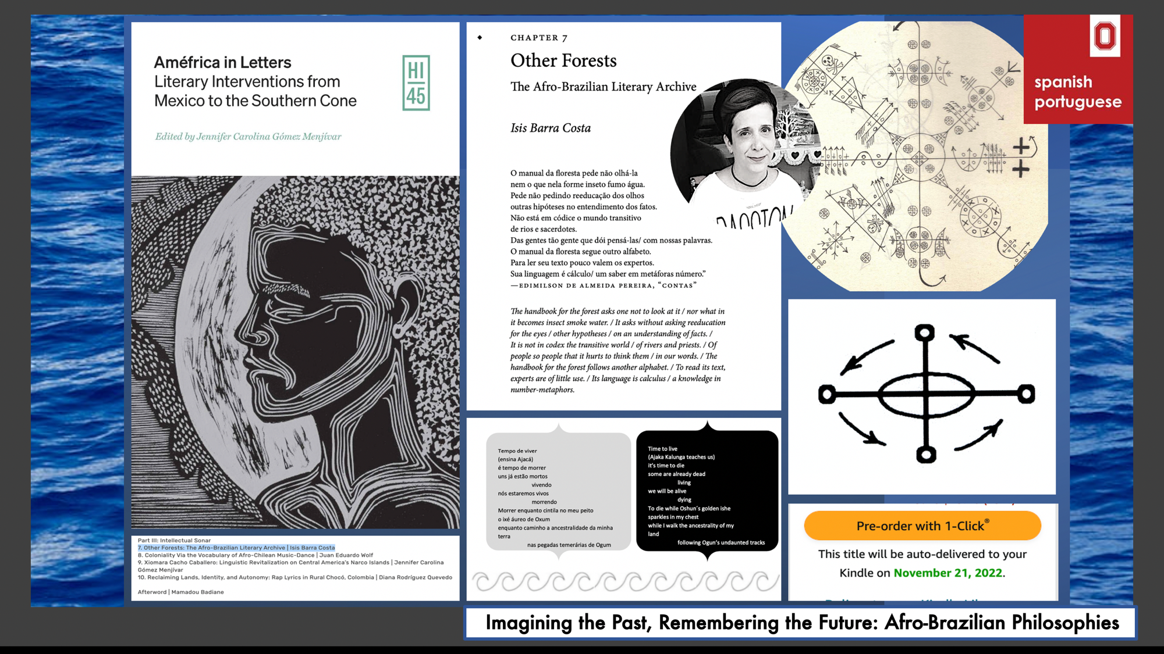

Slide 2
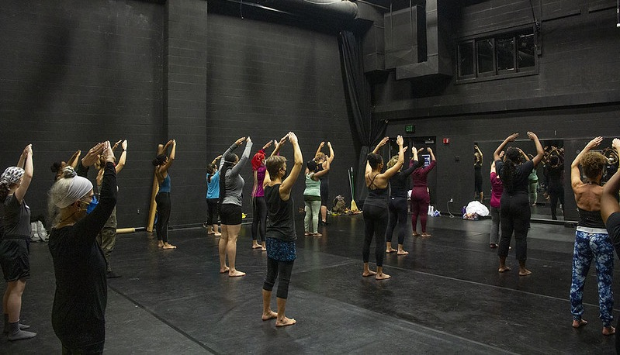
Harmony Bench, Department of Dance
What would it mean to take seriously the idea that dancers’ bodies are themselves archives, and that the language used in dance training is a shared repository of embodied knowledge?
With support from an A&H Larger Grant, my collaborator Kate Elswit (Univ. of London) and I are working with the Institute for Dunham Technique Certification to research the visual imagery used to teach and transmit key components of Katherine Dunham’s dance technique.
Institute for Dunham Technique Certification summer conference University of Southern Indiana July 17-23, 2022. Photo Credit: Bree Gant.

Slide 3
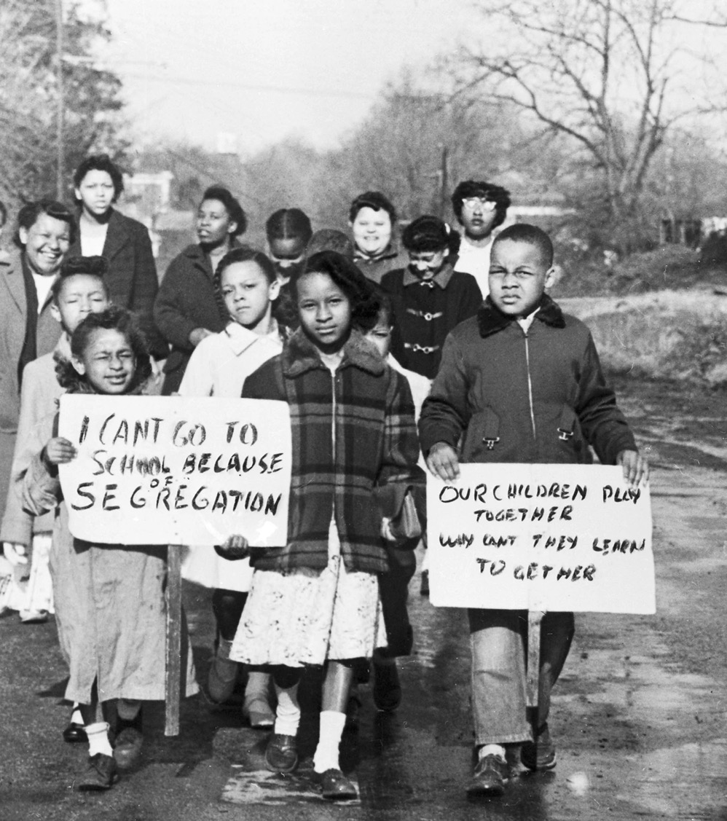
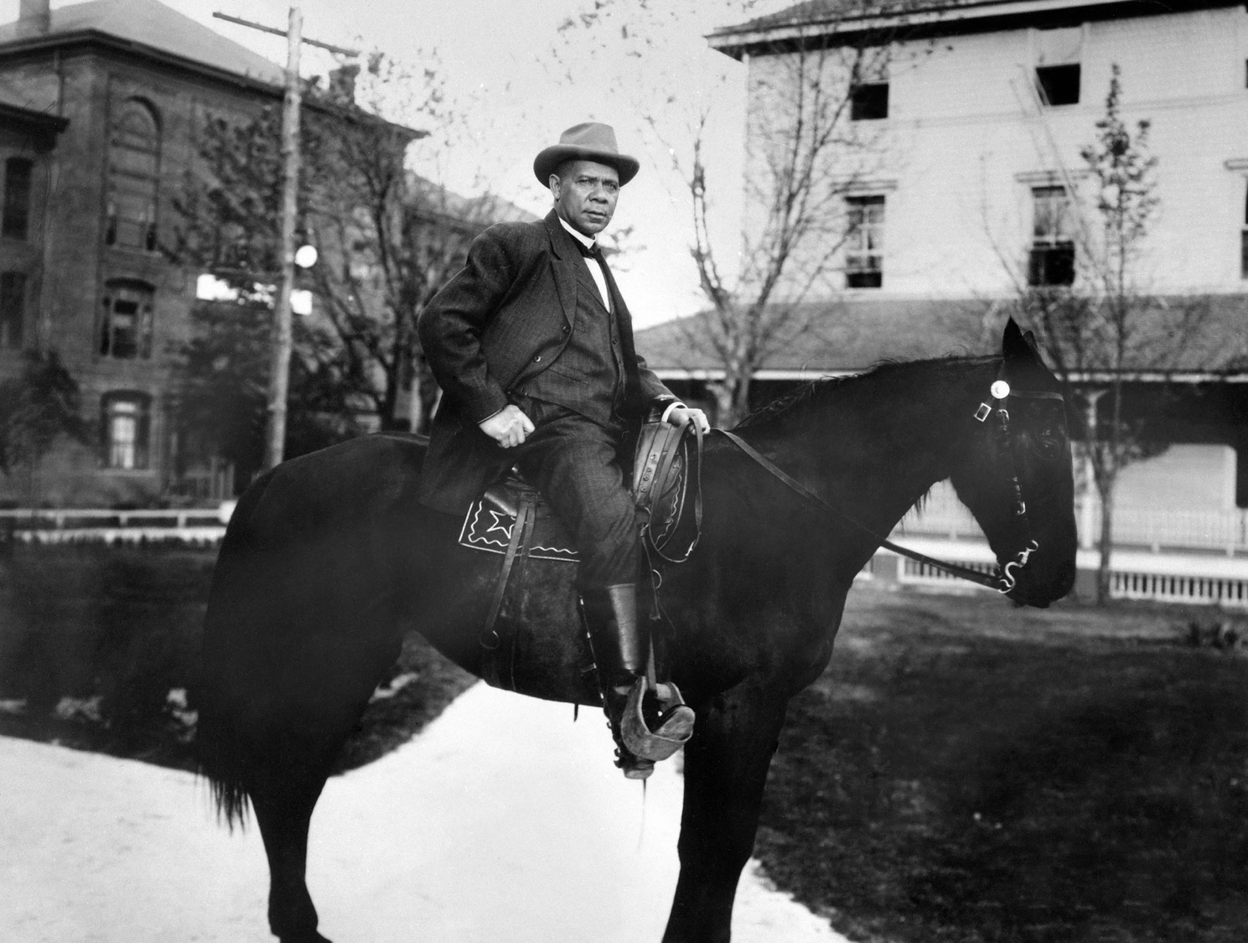
Picturing Black History
Transformative stories & rarely seen photographs of the Black experience https://www.picturingblackhistory.org/
A Collaboration of Origins: Current Events in Historical Perspective and Getty Images
Nicholas Breyfogle, David Steigerwald, Daniela Edmeier, Damarius Johnson, Steven Conn, and Paul McAllister
Department of History

Slide 5
Shakespeare in the “Post”Colonies
“I get the ‘Shakespeare’ part. But what’s this about the ‘Post’Colonies?”
“The post-colonies. You know, the after of empire.”
“Like the British Empire?”
“Like the British Empire. European empire. Colonialism.”
“Places in the after of empire… But that’s fully four-fifths of the world!”
“Now you know why we need to talk about it.”
“But then why the scare-quotes, why ‘Post’Colonies?”
“Because is there an after of empire? Or only an even-now?”
Amrita Dhar & Adélékè Adéèkó
Department of English
shakespearepostcolonies.osu.edu
INTERVIEWS WITH POSTCOLONIAL SHAKESPEARE CREATIVES FROM AROUND THE WORLD

Slide 6

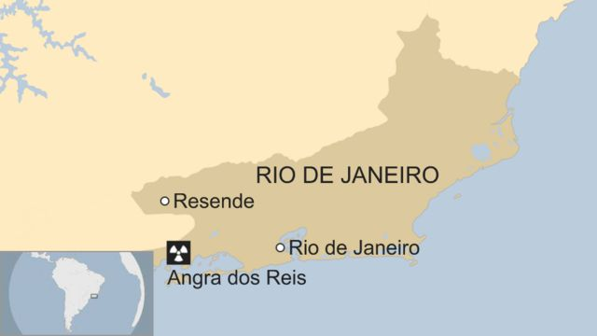
Going Nuclear: The Rise of the Brazilian Nuclear Industry
Jennifer Eaglin, Department of History
“Going Nuclear” historicizes the Brazilian nuclear agenda advanced from the 1940s to the present and its connection to diversifying the country’s energy infrastructure
Westinghouse Electric began construction of Angra I, Brazil’s first commercial nuclear plant, at Angra dos Reis in the early 1970s

Slide 7
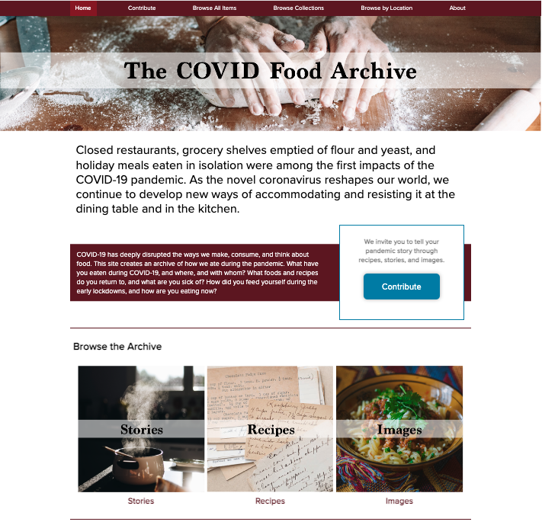
Dr. Philip Gleissner (.4)
Slavic and East European Languages and Cultures
Public humanities projects Resilient Kitchens and
COVID Food Archive
Forthcoming with Rutgers UP in May 2023
250 pages, press run: 5,000

Slide 8
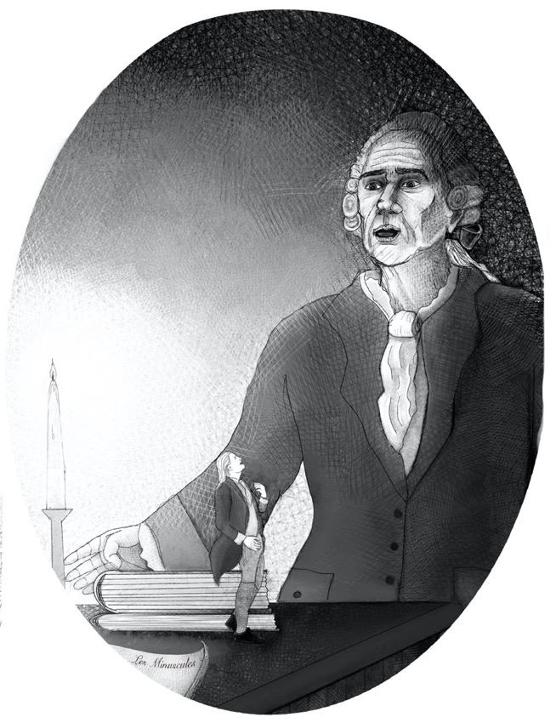
Les Minuscules
A novel by Prof. Benjamin Hoffmann (Department of French and Italian) about Giacomo Casanova (1725-1798) with illustrations by OSU alumna, Julia Barrett

Slide 9
Laws to Save Lives
Clayton Howard
Department of History
The project explores the history of gun control activism in the postwar United States. After 1968, growing numbers of doctors, housewives, lawyers, and other self-identified middle-class Americans expressed deep concern about firearms-related deaths. Like other activists from the era, including environmentalists and abortion rights advocates, gun control proponents framed their issue as a matter of public health. This poster, which resembles anti-smoking announcements in the same period, exemplifies the movement’s concern about safety, wellness, and the public interest.
Handgun Control Poster, U.S. Conference of Mayors, 1981, George Gund Foundation Records, Western Reserve Historical Society

Slide 10
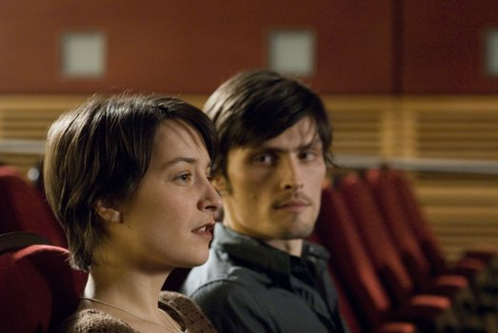
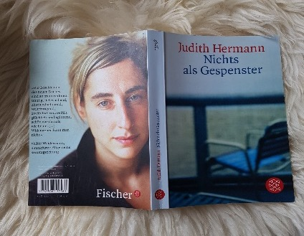
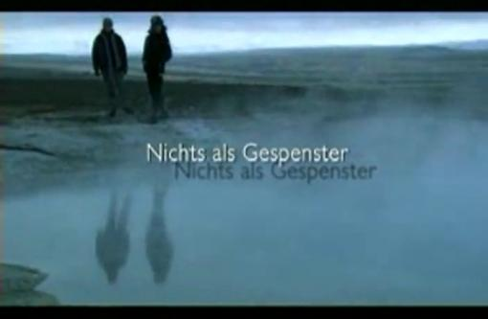
Steven Joyce, Associate Professor
Department of Germanic Languages and Literatures
Monograph
“Judith Hermann's Nichts als Gespenster (Nothing but Ghosts): Ambient Romance and the Politics of Sane Disenchantment.”
Steven Joyce, Associate Professor
Department of Germanic Languages and Literatures

Slide 11
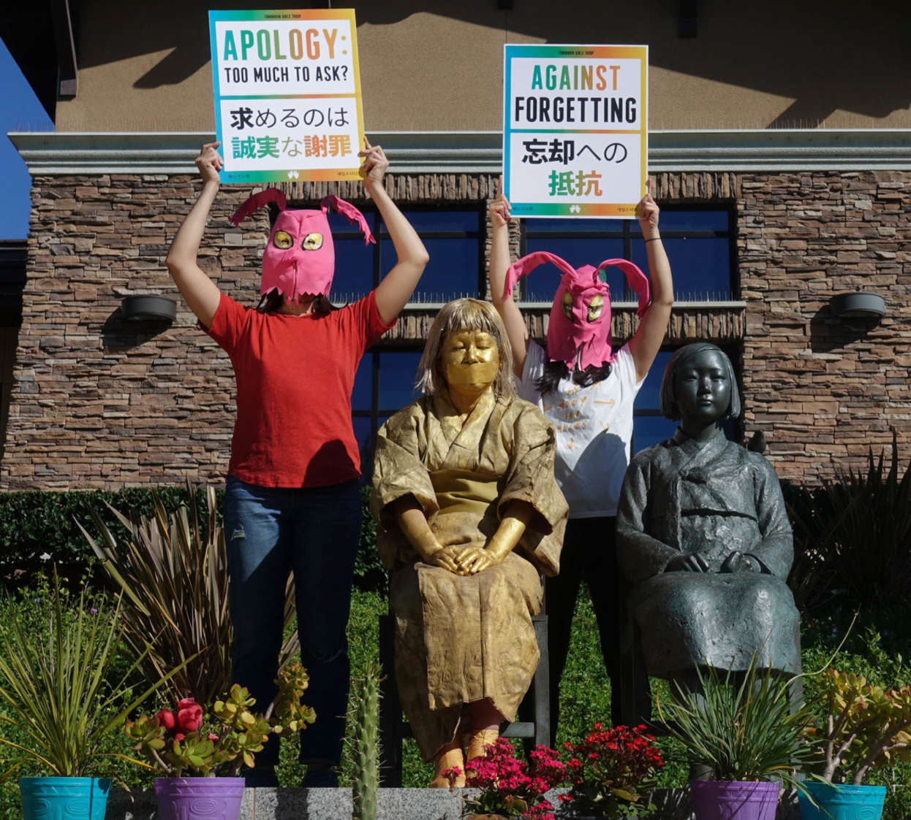
Transpacific Erasures: Contemporary Art, Gender, Race, and the Afterlives of Japanese Imperialism
Namiko Kunimoto,
Associate Professor
Director, Center for Ethnic Studies
Ohio State University

Slide 12
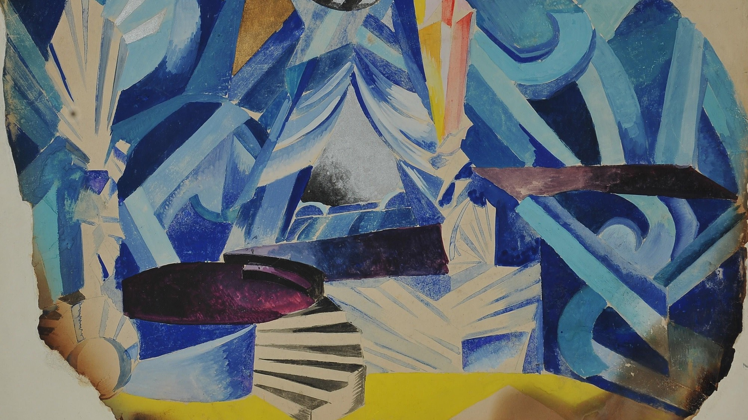
Theatrical Consciousness: Russian Theorists of the Actor’s Mind
Monograph for Northwestern University Press
Dr. Alisa Ballard Lin (.3183)
Slavic and East European Languages and Cultures
The Ohio State University

Slide 13
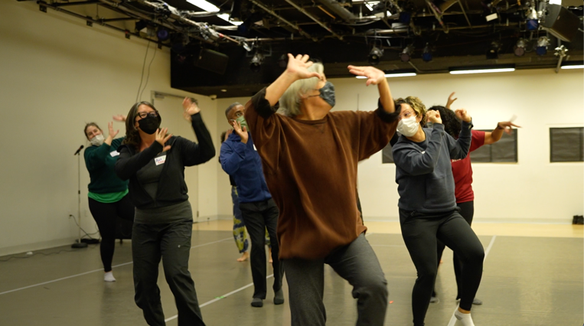
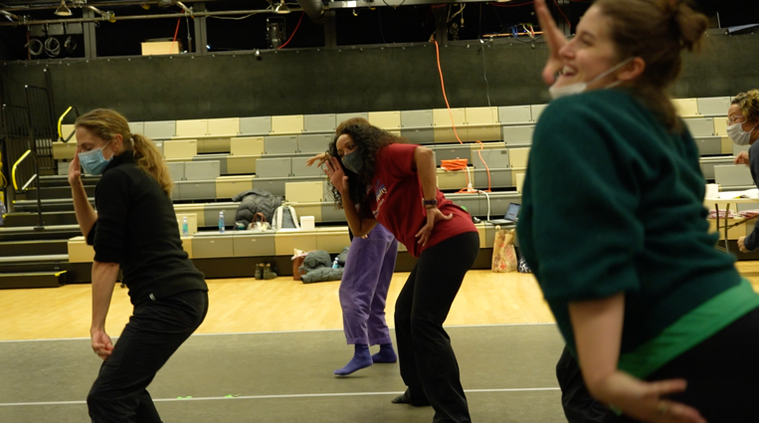
Liberation Dance Education Workshop
Nyama McCArthy-Brown, Department of Dance
Convened in New York with high impact dance educators
to explore questions such as:
How can teacher identity be oppressive in the learning space?
Ho w to facilitated the acquisition of joy in the body?

Slide 14
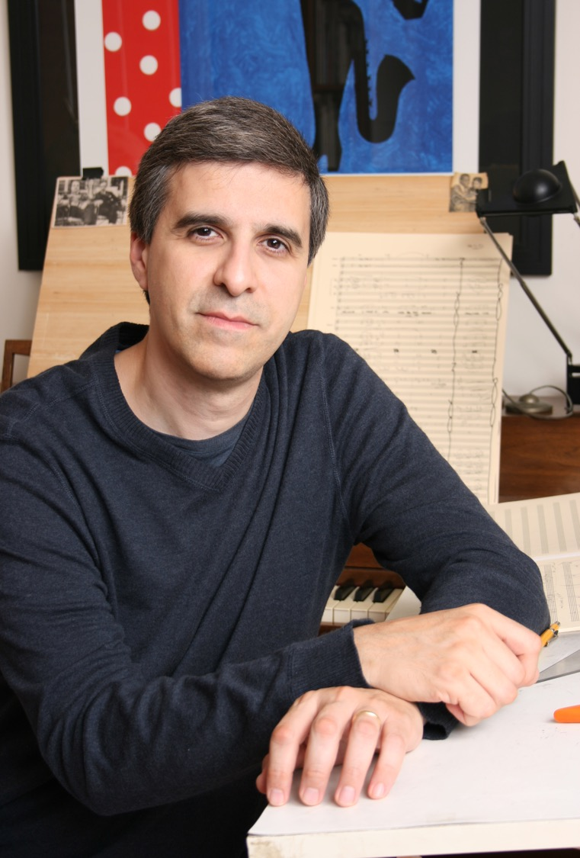
SCHOOL OF MUSIC
Commission of an original 14-minute composition for Wind Symphony and Solo Brass Trio by 6-time Grammy winner Vince Mendoza.
The composition, Shining Pathways, Moving Mountains, was premiered by the Ohio State University Wind Symphony at the dedication of the Timashev Family Music Building.
Professor and Director of Bands Russel C. Mikkelson wrote the grant and conducted the premiere performance.
Solo Brass Trio and collaborative artists: Professors Timothy Leasure, trumpet, Bruce Henniss, horn, and Sterling Tanner, trombone.

Slide 15
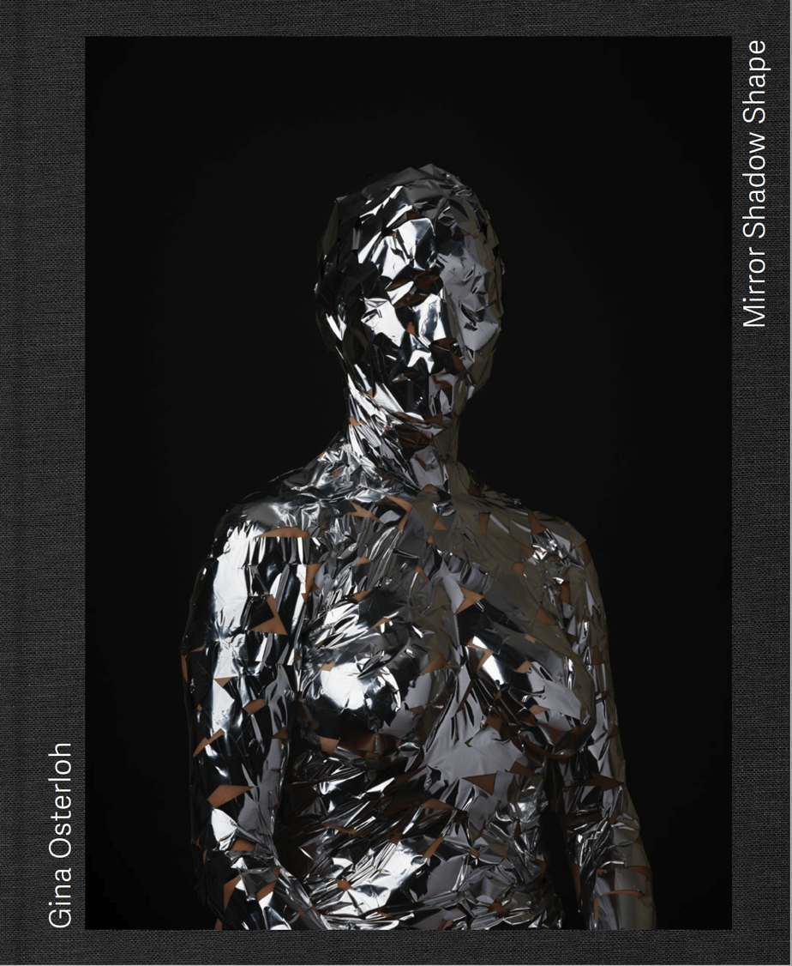
Solo museum exhibition and printed book
Columbus Museum of Art
Mirror Shadow Shape
Gina Osterloh, Department of Art
Exhibition dates:
February 24 – October 8, 2023
Hope to see you there!

Slide 16
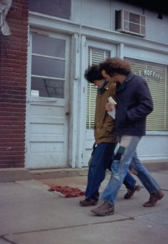
Reading Cruelty in 20th-Century Latin American Literature
Book by Ashley Hope Pérez
Department of Comparative Studies
Under contract for publication with the Theory and Interpretation of Narrative Series (The Ohio State University Press)
Still image from performance piece,
People Looking at Blood, Moffitt (1973)
By Ana Mendieta

Slide 17
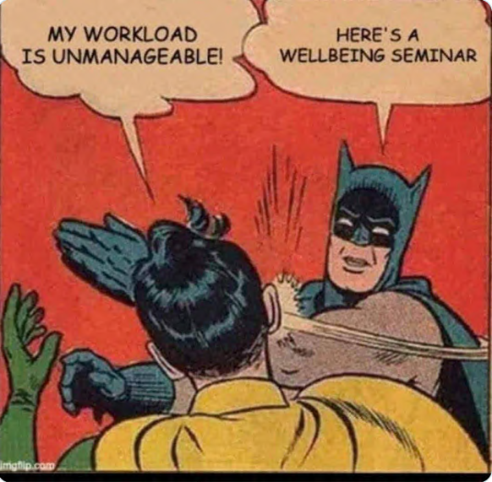
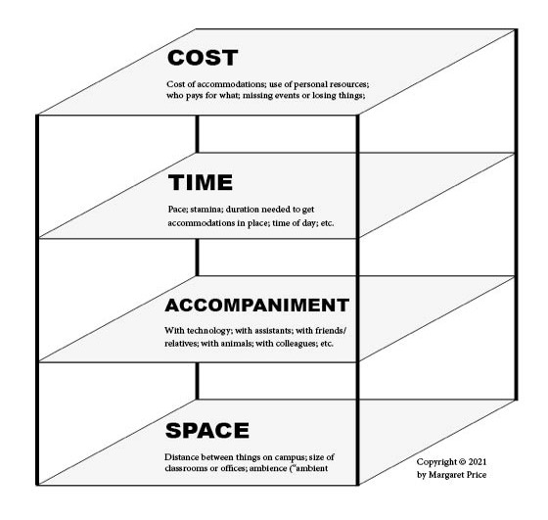
The Disabled Academics Study
Dr. Margaret Price
Department
of English
Disability Studies Program
A mixed-methods investigation of what does and doesn’t work in efforts toward access and inclusion in higher education. Forthcoming as a scholarly book from Duke University Press (2024).

Slide 18
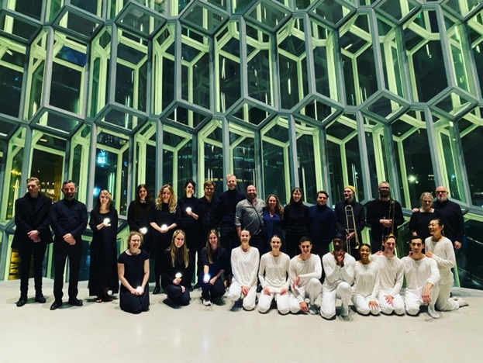
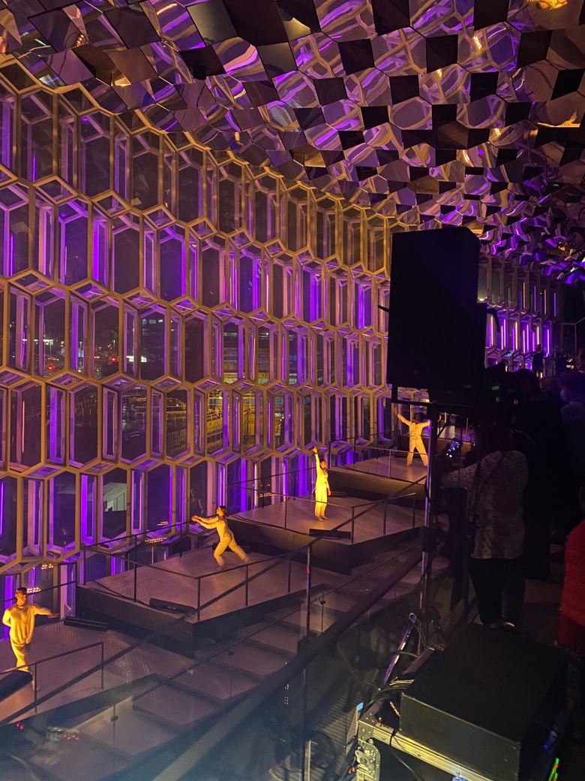
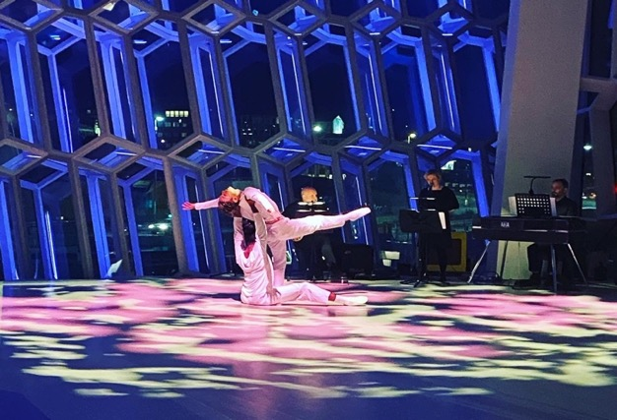
International Performance, Tour Planning
Are we Ok?
dance and music project
Daniel Roberts, Associate Professor
Department of Dance

Slide 19
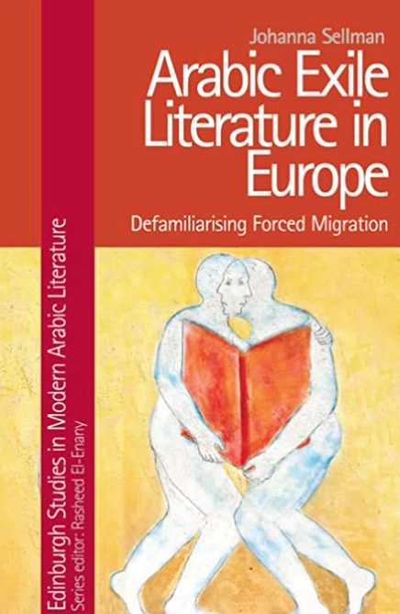
Book: Arabic Exile Literature in Europe: Defamiliarizing Forced Migration
Johanna Sellman
Department of Near Eastern and South Asian Languages and Cultures

Slide 20
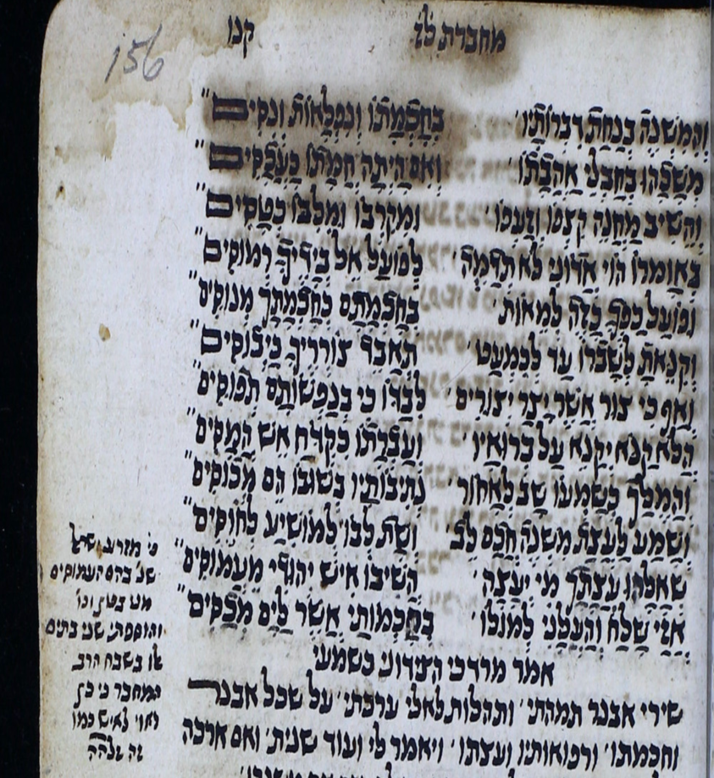
Adena Tanenbaum
Dept. of Near Eastern and South Asian Languages and Cultures
Monograph:
Beguiling Guidance: Zechariah Alḍāhirī’s“Book of Moral Instruction” (Sefer Hamusar), a Hebrew Maqāma from 16th-century Yemen
Chapter 2 Literary Dimensions: Maqāma, Musar, Narrative and Poetic Techniques

Slide 21
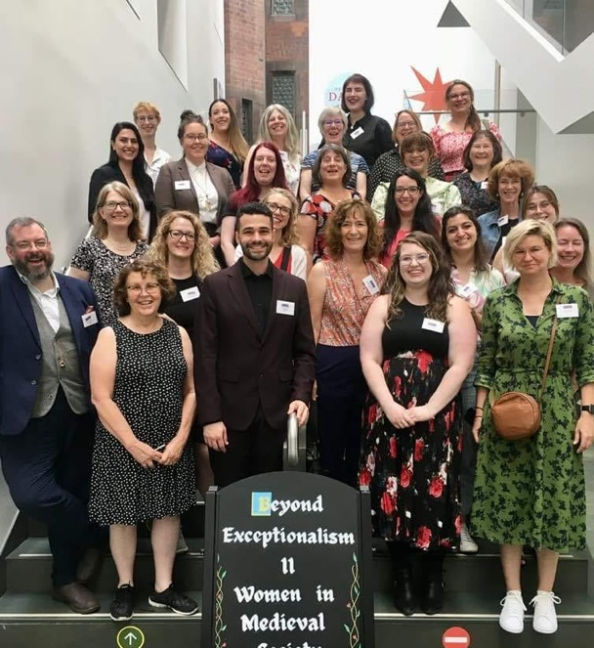
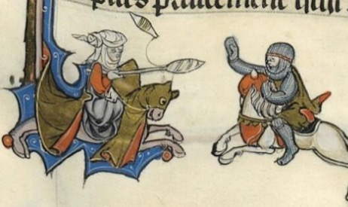
Beyond Exceptionalism II
Conference (11-13 July)
Heather J. Tanner
Associate Professor of History
International & Interdisciplinary Conference at John Rylands Library (Manchester UK)
Addressing the myth of medieval women’s powerlessness and inability to influence communities and realms, as well as fostering new interpretations and methodologies.

Slide 22
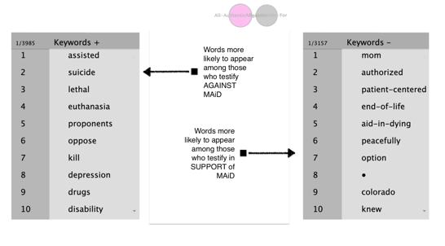
Terminal Dignities: A Rhetorical Analysis
Human Dignity Project: u.osu.edu/humandignity
www.christateston.com
COLLEGE OF ARTS & SCIENCES | DEPARTMENT OF ENGLISH
Christa Teston, PhD
Undergraduate Research Assistants: Olivia Andresen & Rheanna Velasquez | Supported by College of Arts & Sciences Completion Grant
Research Question
Results: Topological Commonplaces
How are arguments for or against so-called “death with dignity” in the U.S. rhetorically supported? What forms of evidence are invoked as warrants during “Medical Aid in Dying” (MAiD) legislative hearings?
Citizens in Nevada and Connecticut rely on seven “biopolitical topoi” (or argumentative premises) when making arguments for or against Medical Aid in Dying Legislation (MAiD). Those who testified against MAiD mobilized the “Cost” and “Vulnerability” topoi twice as often as those who testified in support of MAiD.
Codes of conduct
Cost
Kinship
Pain-Control
Precedent
Safeguards
Vulnerability
Table 1. Battin’s (2005) “principal arguments” in the MAiD debate
Arguments for MAiD | Arguments against MAiD
Autonomy Relief of pain and suffering | The intrinsic wrongness of killing Integrity of the medical profession Risk of potential abuse (aka “the slippery-slope argument)
Methods
Fig 1. Results from LancsBox analysis of MAiD testimony
Analysis
Corpus Linguistics (using LancsBox)
Summative Content Analysis (using NVivo 12)
Rhetorical Analysis (cf. Walsh & Boyle, 2017)
Debates around MAiD are no longer just about religious convictions and/or pain relief.
Arguments for MAiD legislation tend to pathologize dependency and (unwittingly) rely on eugenicist logics.
Contemporary “death-with-dignity” discourse frames some persons as more biopolitically disposable than others.
Data
Written testimony and meeting minutes from two states’ MAiD hearings:
Nevada’s 2017, 2019, and 2021 MAiD Hearings
Connecticut’s 2021 and 2022 MAiD Hearings
Selected Bibliography
      Battin, M.P. (2005). Ending Life: Ethics and the Way We Die. Oxford University Press.
      Walsh, L., & Boyle, C. (2017). Topologies as techniques for a post-critical rhetoric. Springer International Publishing.

Slide 23
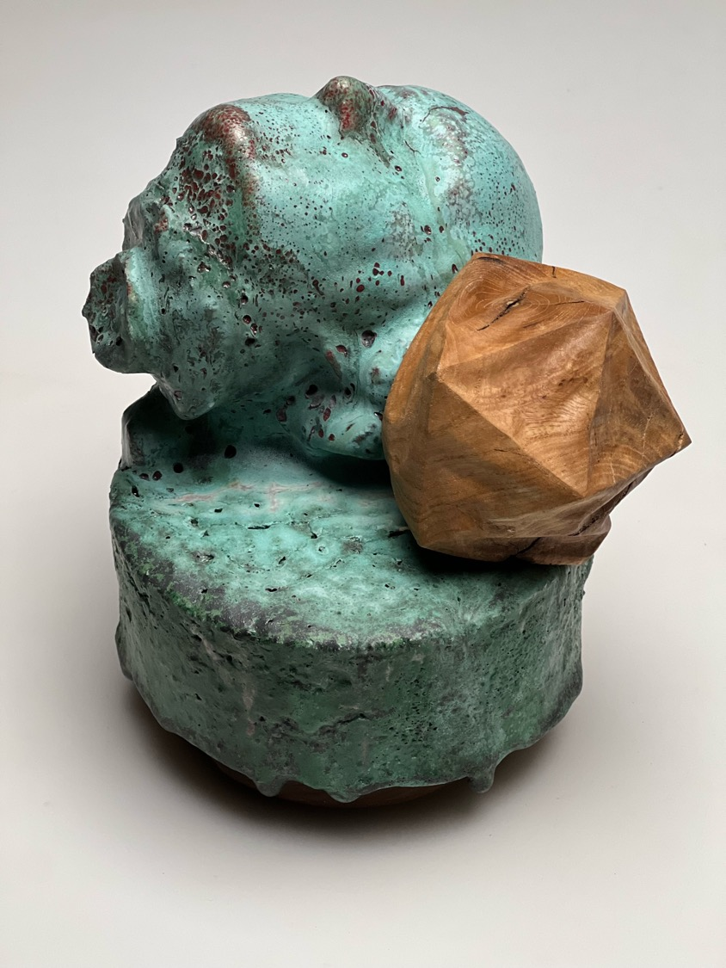
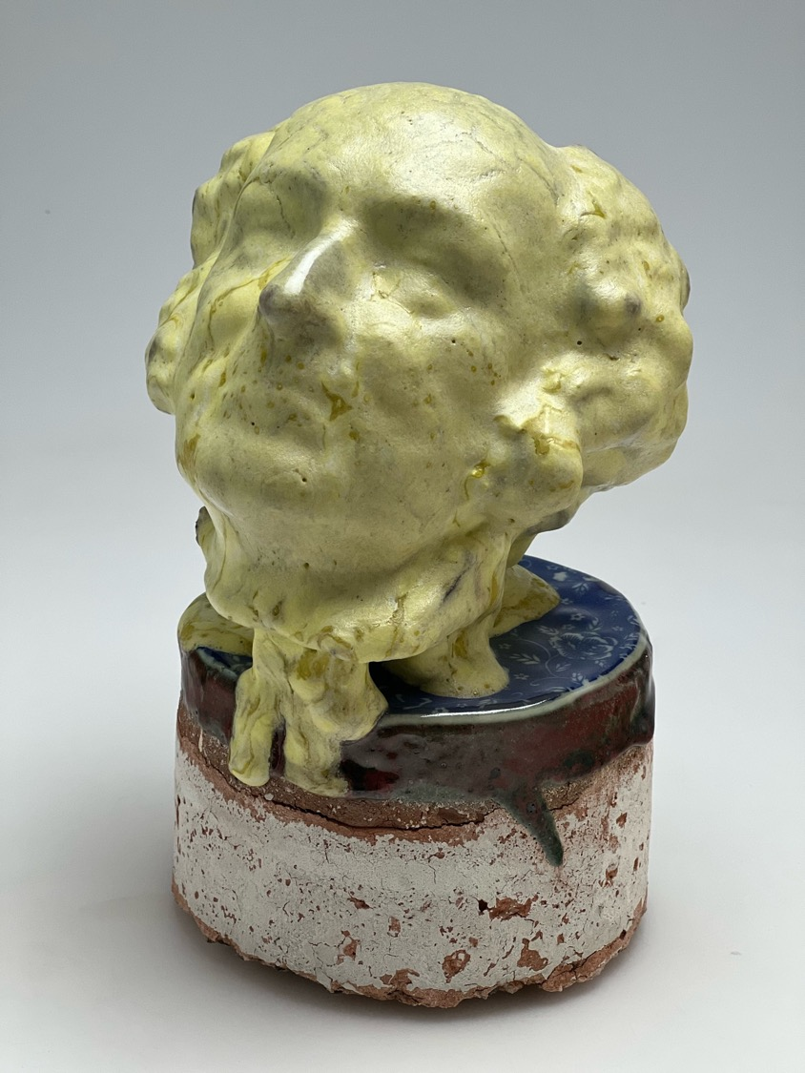
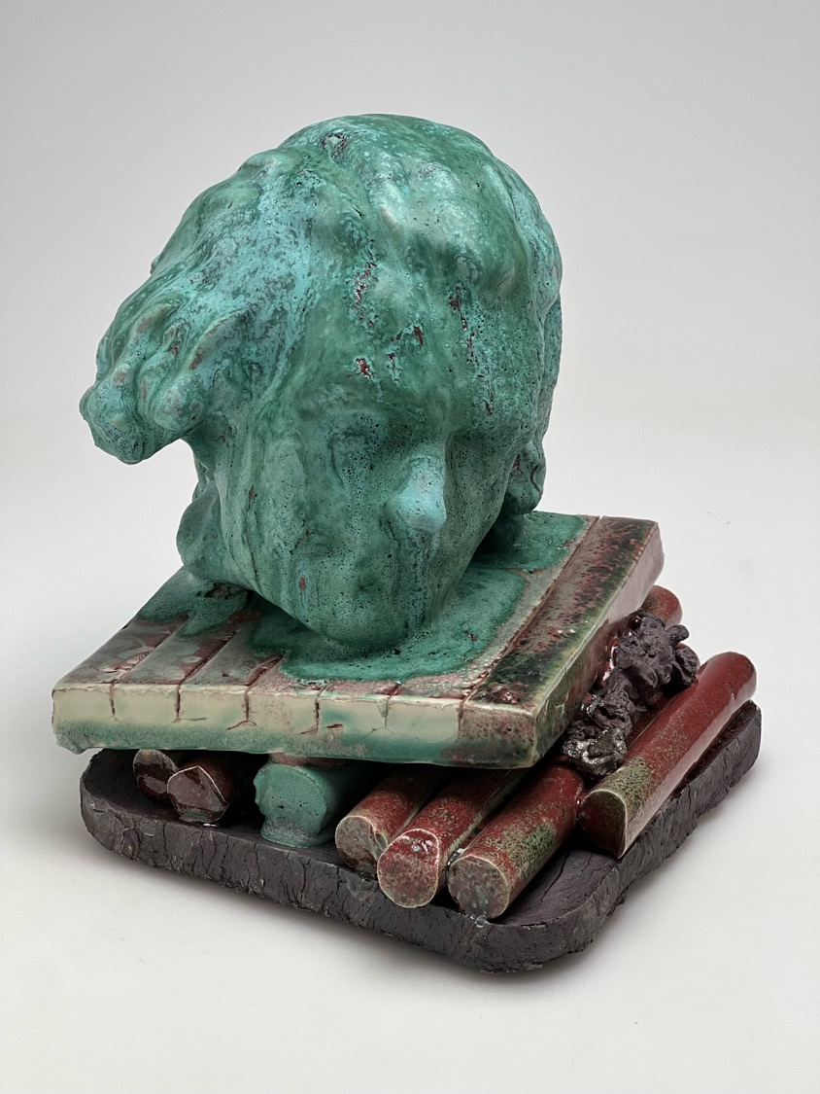
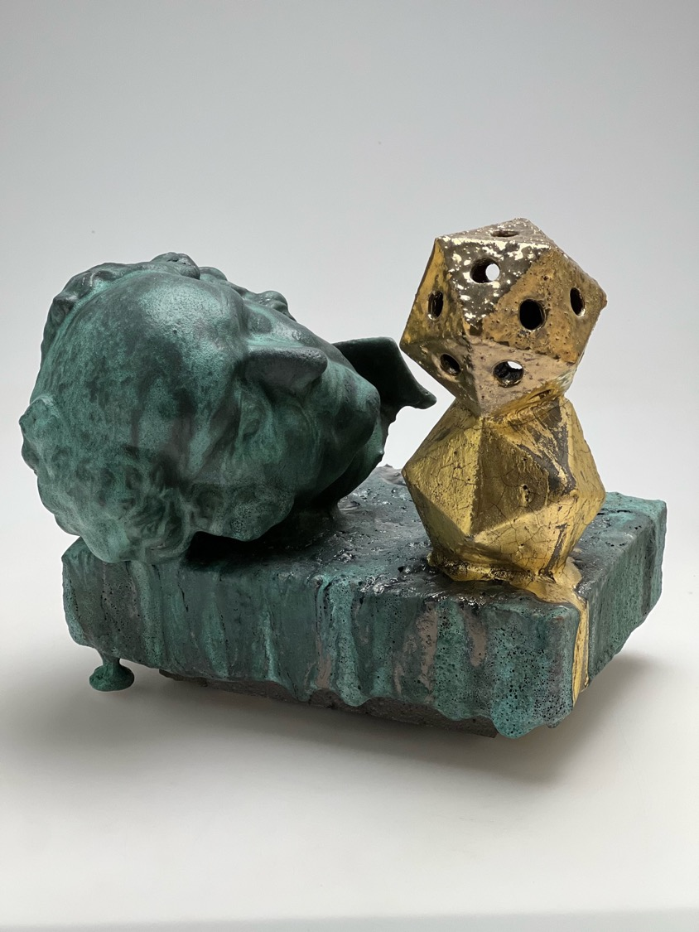
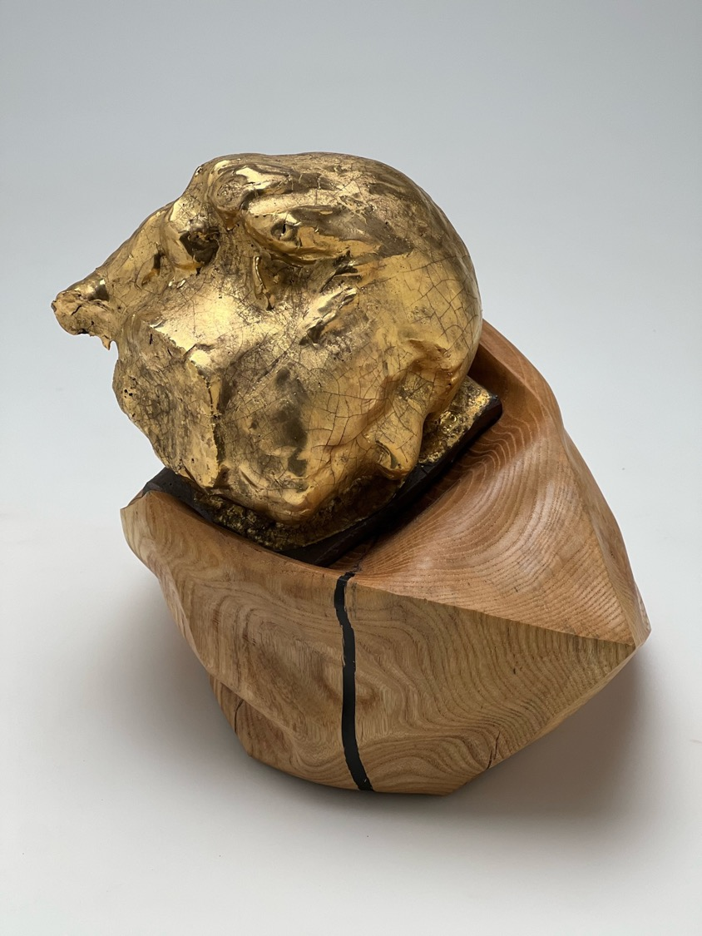
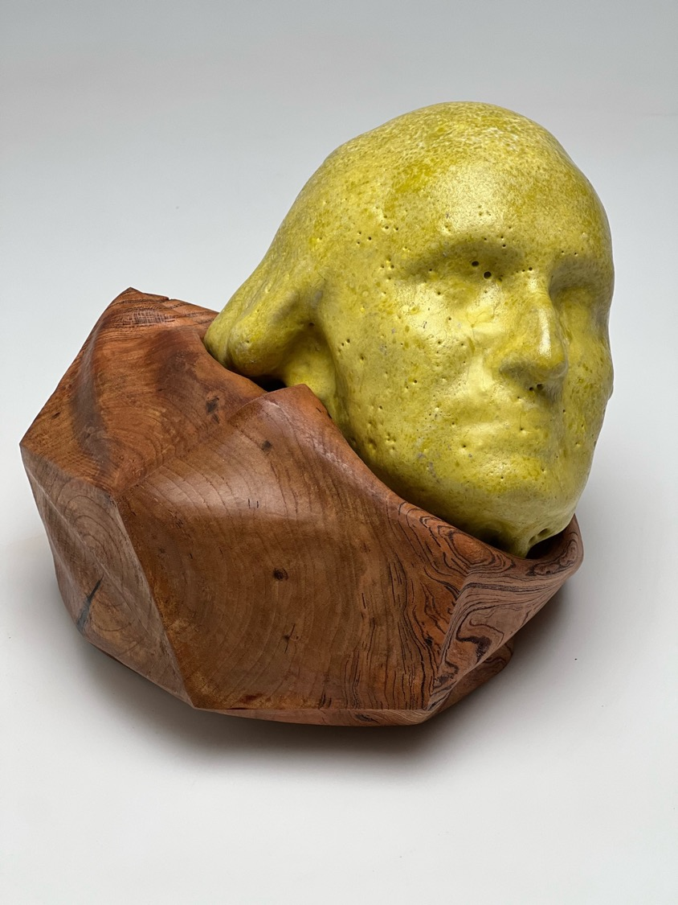
Benjamin on a Dodecahedron
George with an Icosahedron
George on an Octahedron
John on Patterned Cylinder
John with an icosahedron Stack
Thomas on a Sliding Stack
Steven Thurston
Associate Professor Department of Art
Large Grant Recipient
George on a Dodecahedron
Lost in Translation- Deception and Desire
This research project is very much grounded in material exploration and translational misinterpretations. The work seeks to exploit how desires enable deception and how deception promotes misunderstanding. Layered with historical references, this work is grounded within the emotional pursuits of understanding the chemical and physical transformation of earth into meaning. Pictorially, the chosen busts are intentionally fragmented from their origins and purposely situated on plinths of wood or clay. The wooden pillows are carved from large blocks to offer a juxtaposition within the familiar and capture a false display of rest. The clay plinths are deliberately solid and overflowing with glaze as if to consume and bury the mythologies surrounding the subjects. Each composition explores the alchemy of porcelain. The altered formulas within each test material limits and creates new amalgams of ceramic form
- A contemporary quest to turn lead into gold.
Porcelaneous Castable, Reduction Fired
Copper Glazes, Ash and Black Elm
7”H x 8”w x 8”D 2022
Porcelaneous Castable, Reduction Fired
Cobalt and Copper Glazes, Gold Luster, Ash
9”H x 10”w x 7”D 2022
Porcelaneous Castable, Reduction Fired
Praseodymium Yellow Glazes, Cherry
8”H x 9”w x 9”D 2022
Porcelaneous Castable, Reduction Fired Copper Glazes, Refractory Brick, Gold Luster
9”H x 9”w x 4.5”D 2022
Porcelaneous Castable, Reduction Fired Copper Glazes, Porcelain and Red Clays, Printed Underglaze
8”H x 9”w x 9”D 2022
Porcelaneous Castable, Reduction Fired Praseodymium Yellow Glazes, Dimensional Glaze with Printed Underglaze 11”H x 6”w x 7”D
Porcelaneous Castable, reduction fired Copper Glazes,
Gold Luster, Ash 16”H x 13”w x 12”D 2022

Slide 24
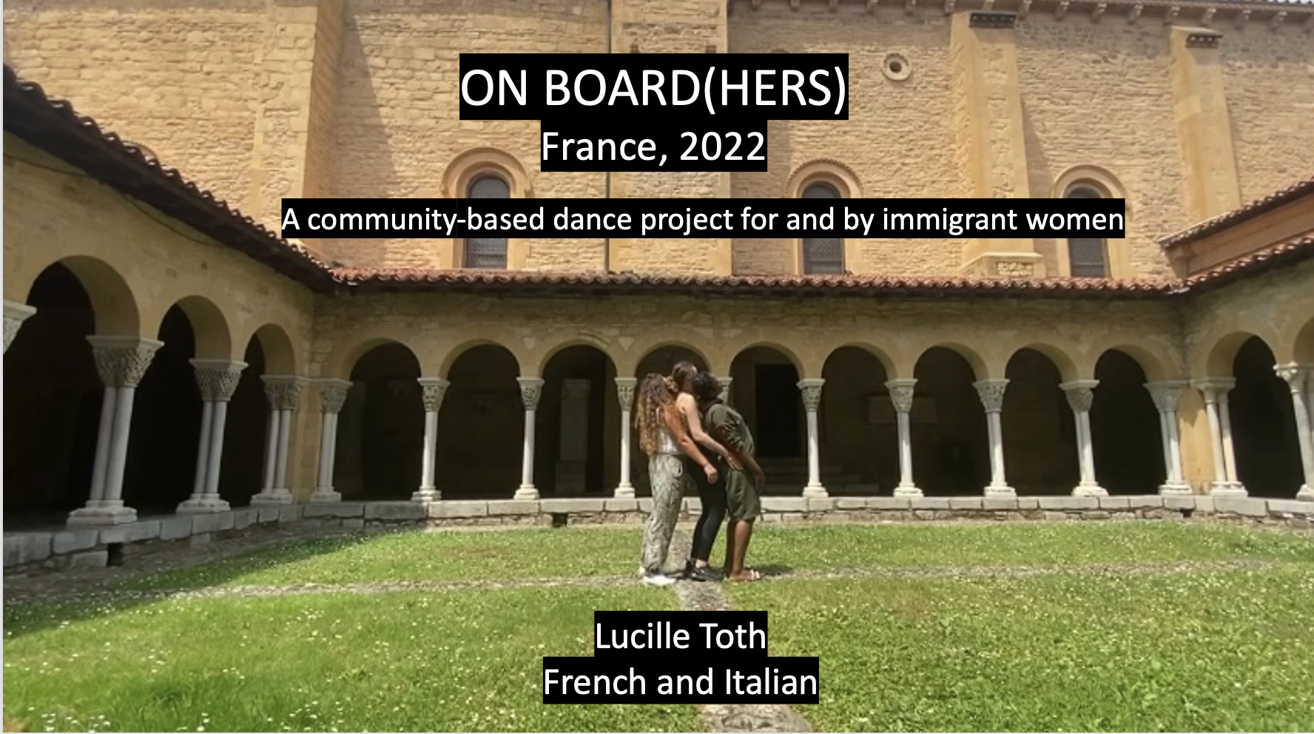

Slide 25
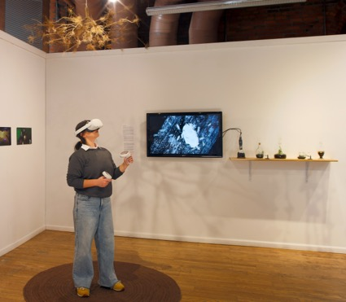
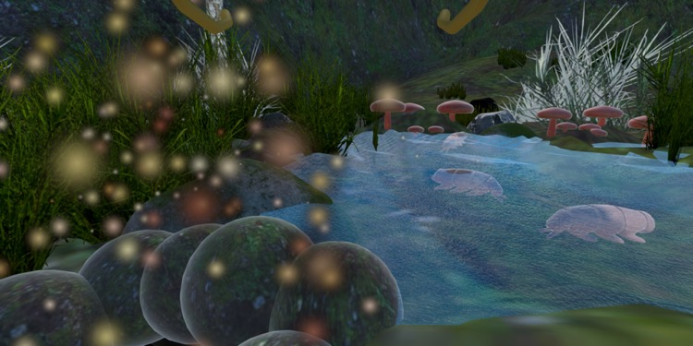
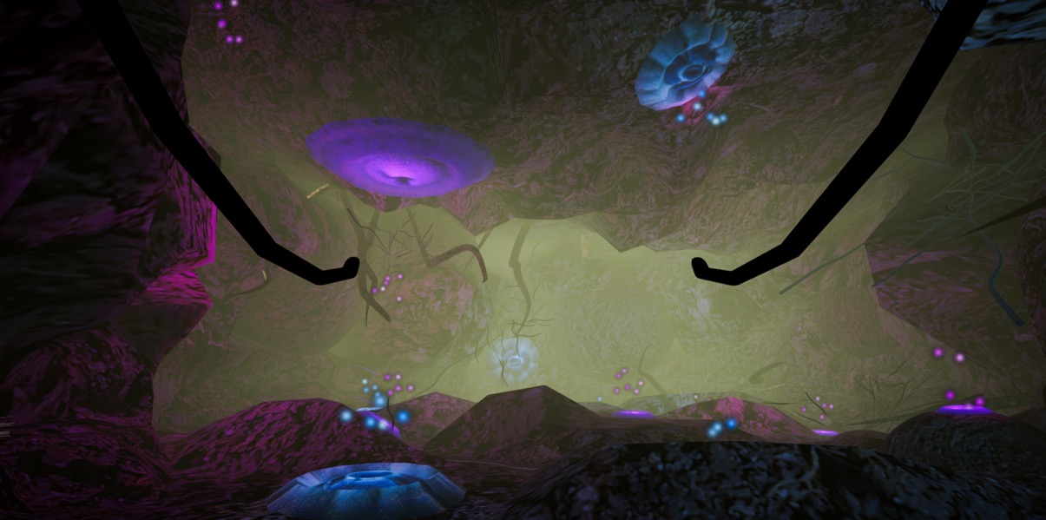
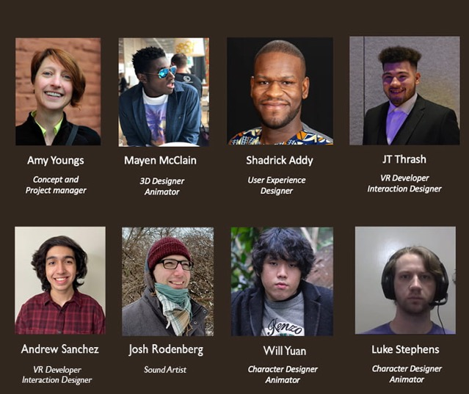
BELONGING TO SOIL
A Virtual Reality experience that simulates an underground soil world inhabited by creatures that can be “embodied” by people. Our goal is to create a playful, open-ended, underground soil world.
Department of Art
Department of Design
Advanced Computing Center for the Arts and Design
RESEARCH TEAM
https://u.osu.edu/belongingtosoil
Images from Earth Is Us exhibition and VR experience gameplay

Slide 26
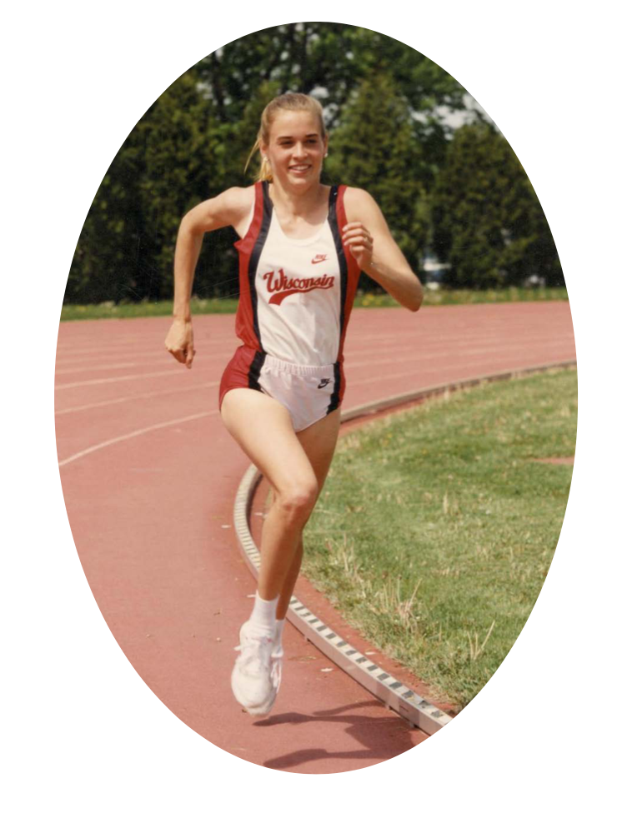
Arts & Humanities Completion Grant
How We Practice by Carmen Winant
Roy Lichtenstein Chair of Studio Art, Associate Professor,
Department of Art, The Ohio State University
This book considers a single question: what is practice, and how and why do contemporary artists use the word so relentlessly? “Practice,” as we would have it, is at once the research, the output, and the engine of our productive lives: the phenomenological experience of being an artist as well as its base, material conditions. The twelve essays in this book disband with the conventional correlation – between art practice and professional, white collar, accredited practice – to propose a new, analogous form of understanding and approach: athletic practice. Winant is a former competitive long-distance runner who attended practice once or twice a day for a decade; this book of essays mines that protracted experience, deeming it worthy of critical inquiry and rife with corresponding meaning in artmaking.
How We Practice will be published by Dancing Foxes Press (New York). Its completion was made possible by this Arts & Humanities grant.

