Slide 1


Slide 2

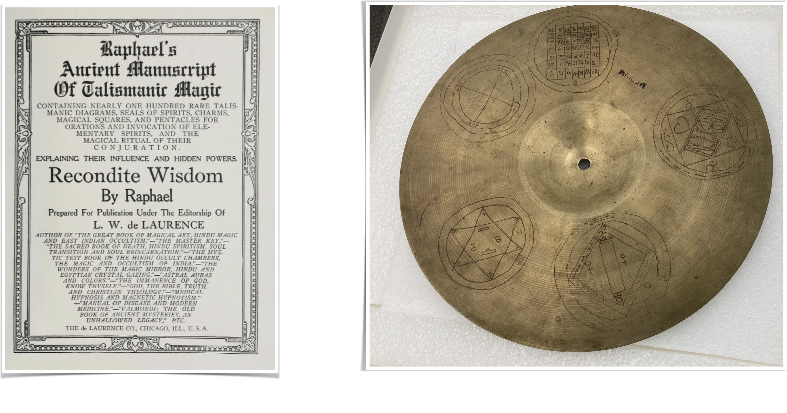
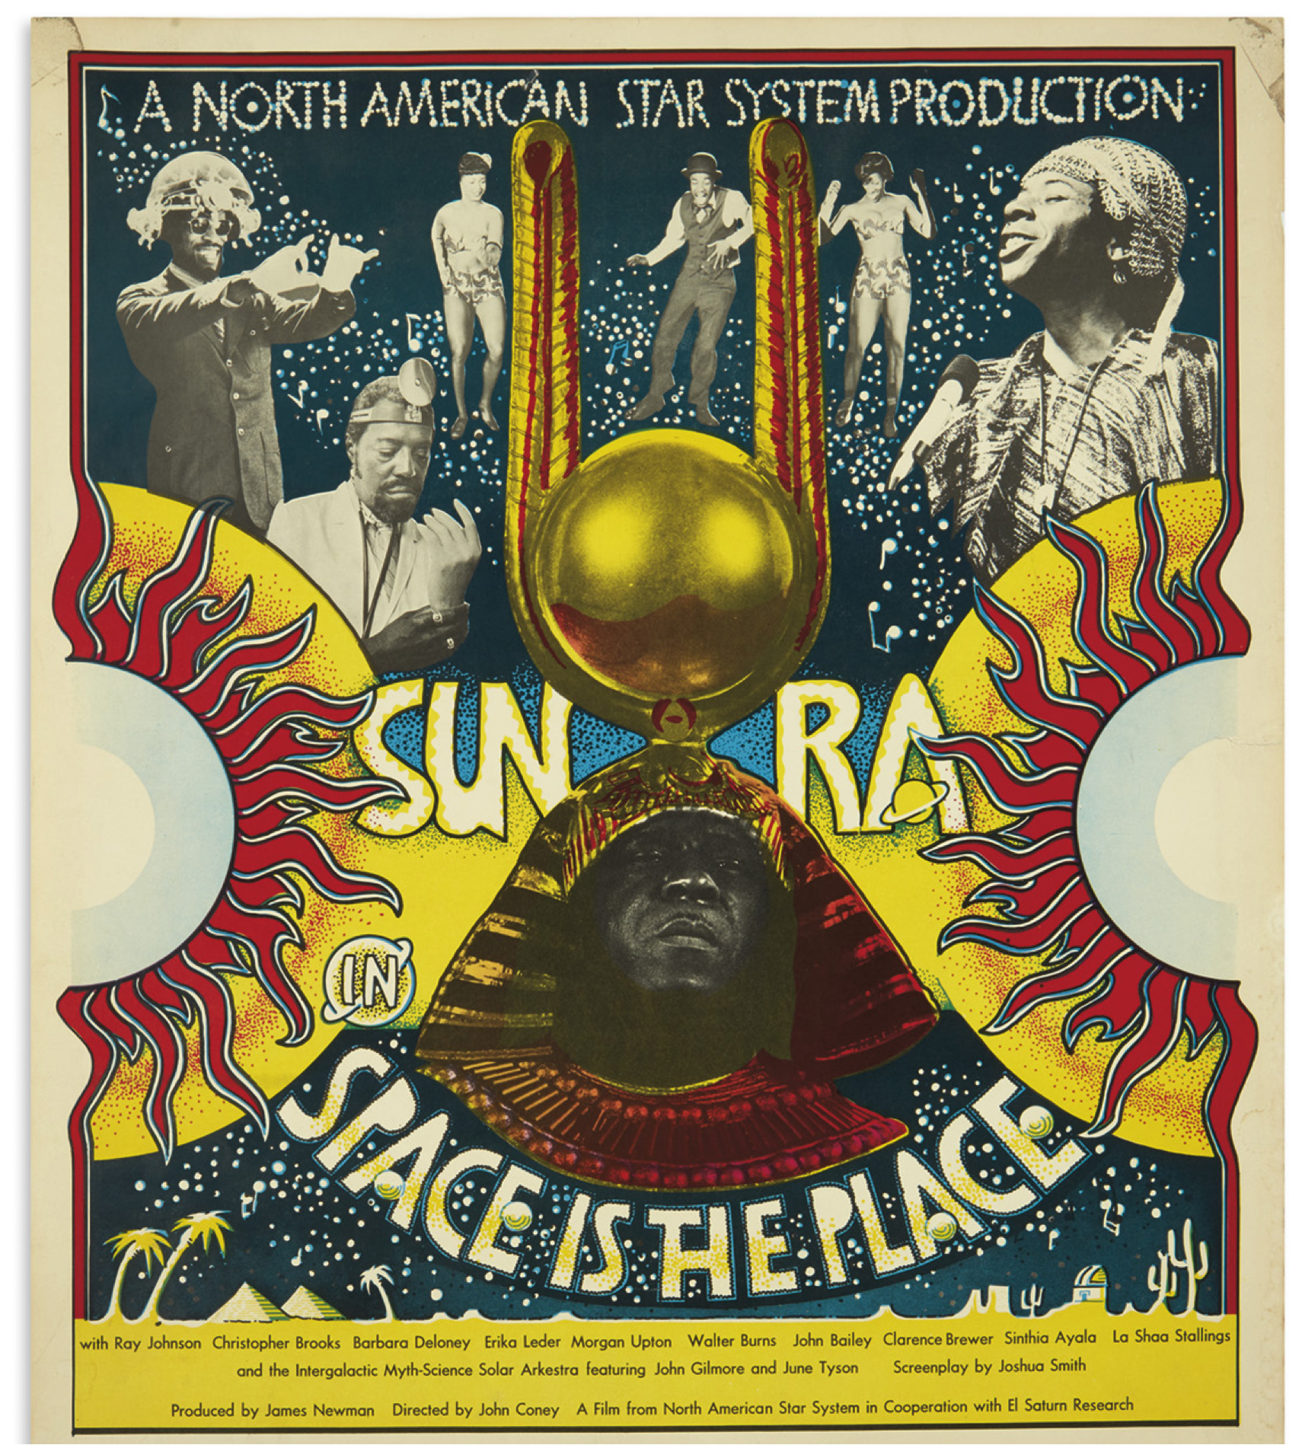
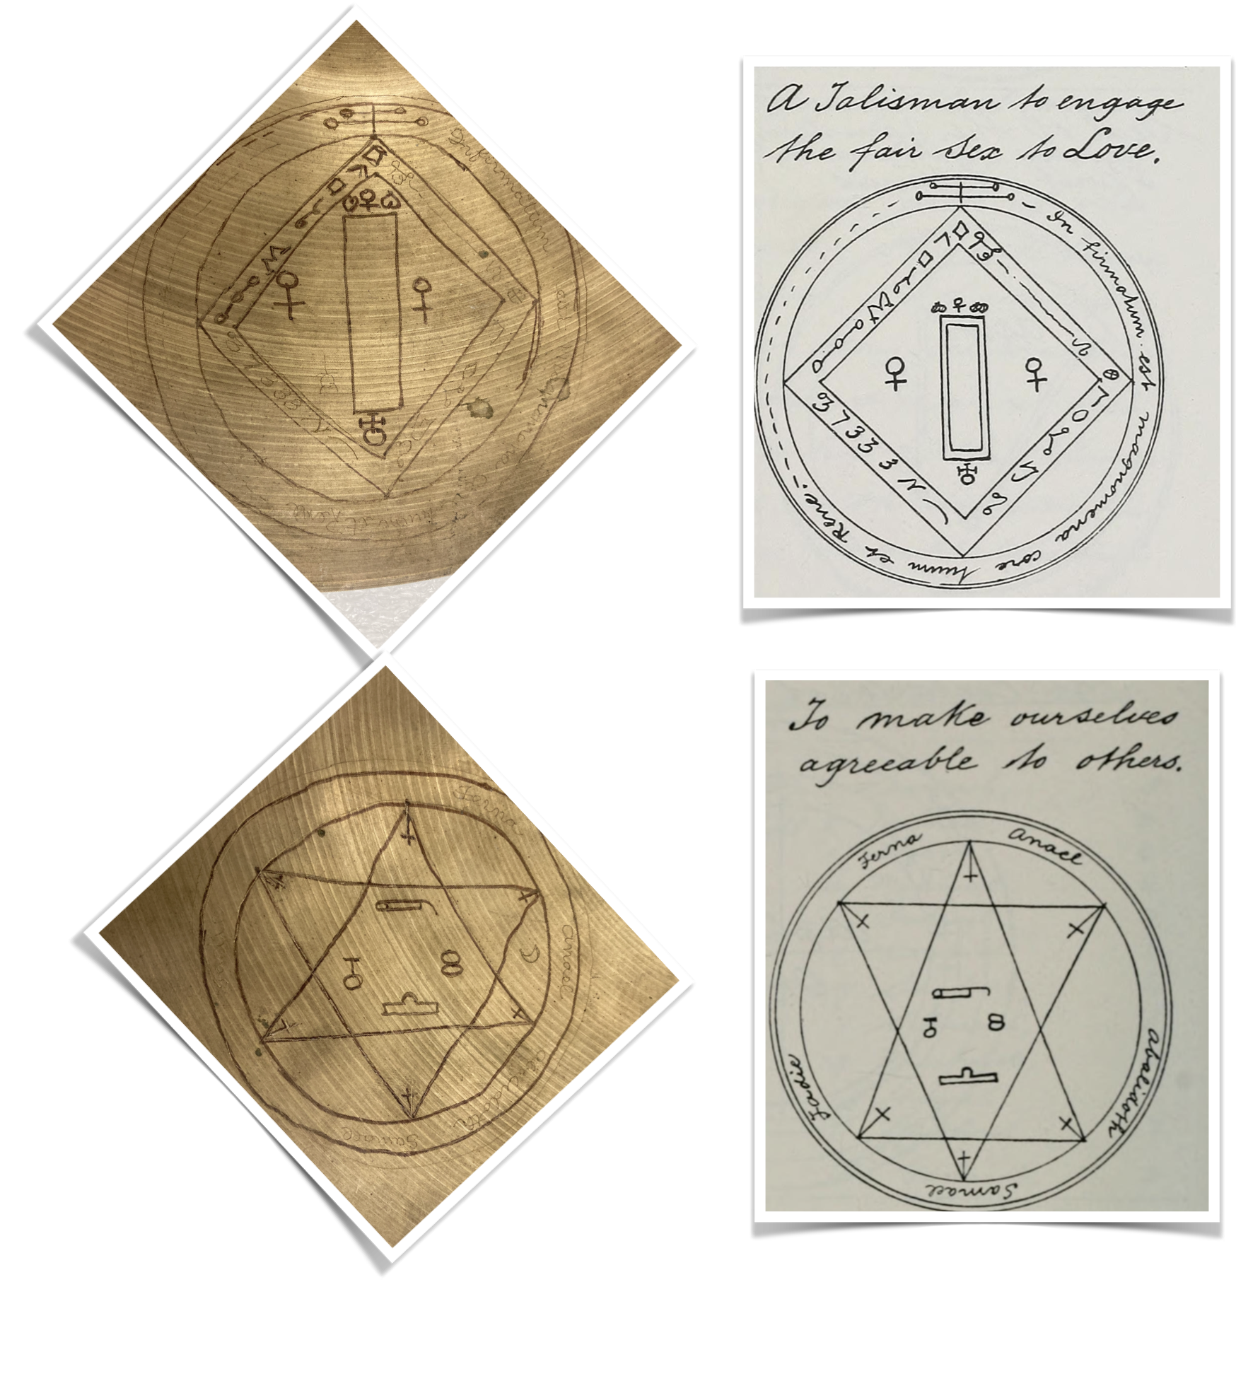
Anna Gawboy, School of Music
“Magic and Music in Sun Ra’s Creative Practice”
Chapter in Esoteric Musical Modernism

Slide 3
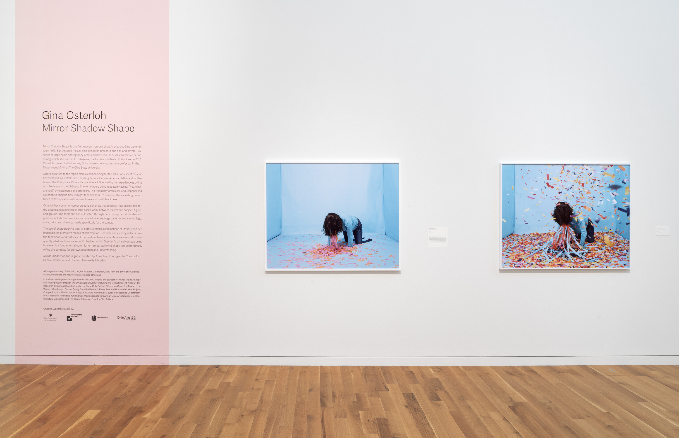
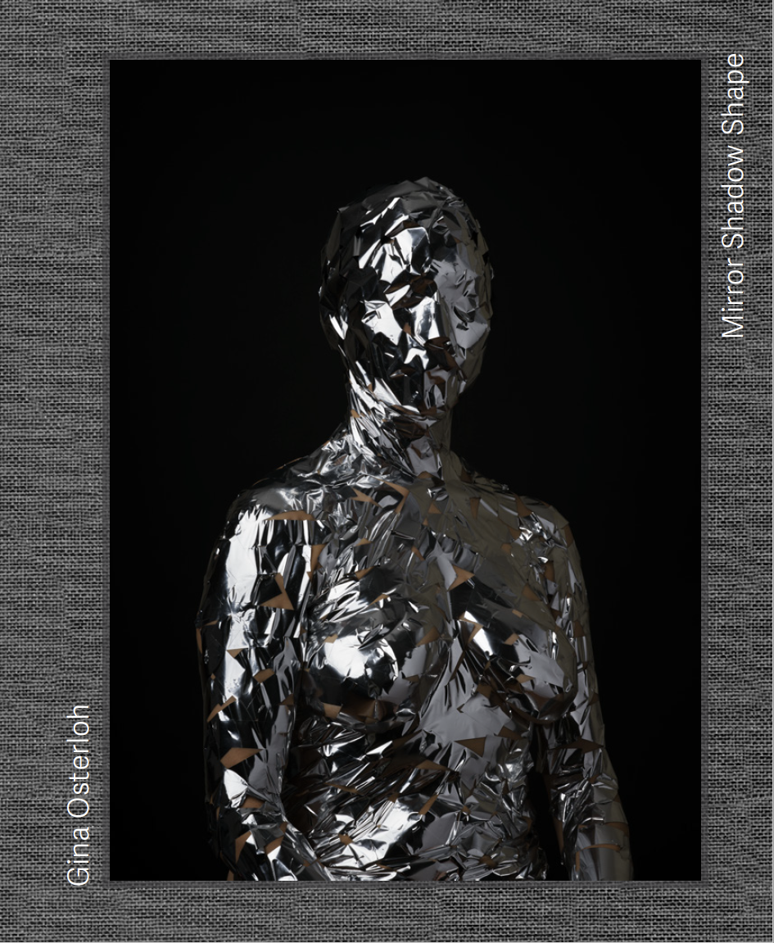
Gina Osterloh: Mirror Shadow Shape at the Columbus Museum of Art
Book publication and museum survey of work from 2005-2020
Associate Professor, Department of Art, Faculty Affiliate Center of Ethnic Studies - Asian American Studies Program
Arts & Humanities Course Release Autumn 2022
Completion Grant & Manuscript Grant to hire an editor, complete production and framing of artwork, and much needed time to complete the exhibition and book.
Exhibition: February 24 – October 8, 2023
Book submitted to printer January 2023, printed and published April 2023
Published by the Columbus Museum of Art
Printed by Die Keure, Belgium

Slide 4
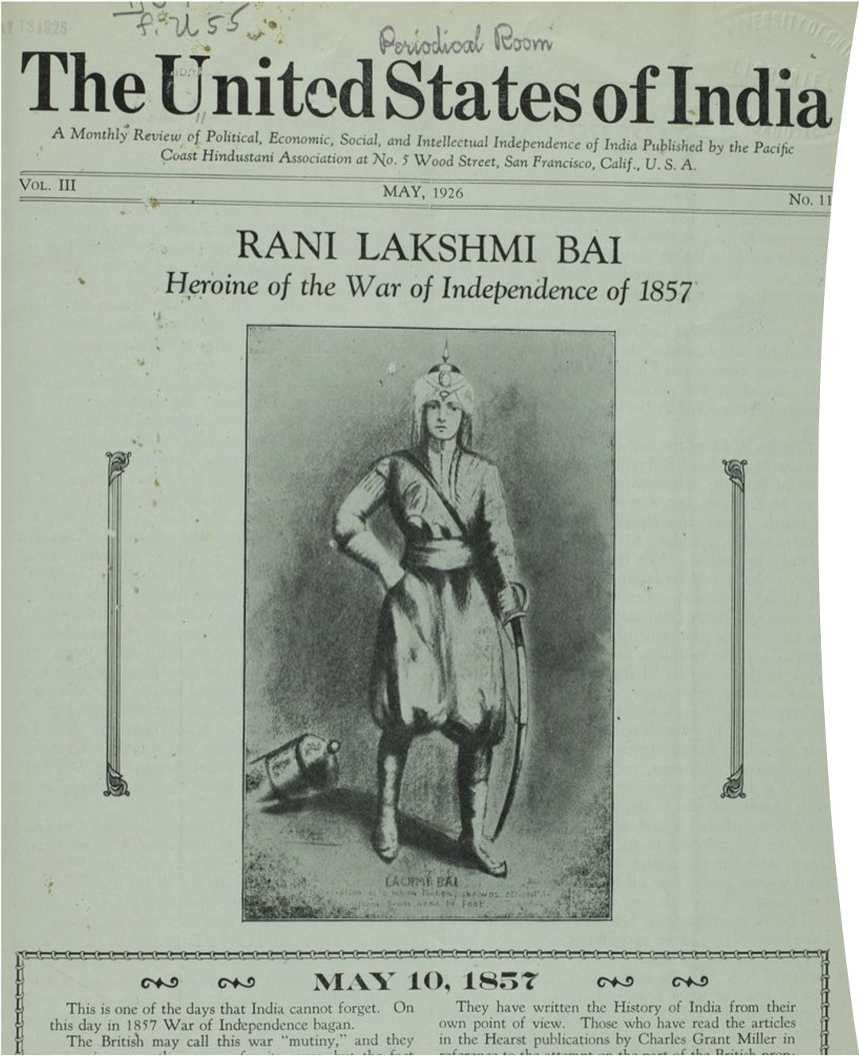
1857 & the Anticolonial Imagination in India:
Militancy, Nationalism & the Specter of Hindutva
Pranav Jani
Anticolonial Militancy:
Why do both right and left celebrate 1857 & the abolition of the British Raj? Where does Gandhi fit in this?:
Feminism & Nationalism:
Is the Queen of Jhansi, the warrior queen of 1857, a feminist icon or a symbol for patriarchy & tradition?
Colonialism & Progress:
Why did many nationalists and leftists agree with Marx that colonialism unconsciously brought progress to Asia?
Nationalism & Liberation:
What are ithe possibilities & limits of anticolonial nationalism in terms of liberation?
From The United States of India, May 1926. Published from Ghadar Party office, San Francisco. South Asians in North American Archives, Bancroft Library, UC Berkeley.

Slide 5
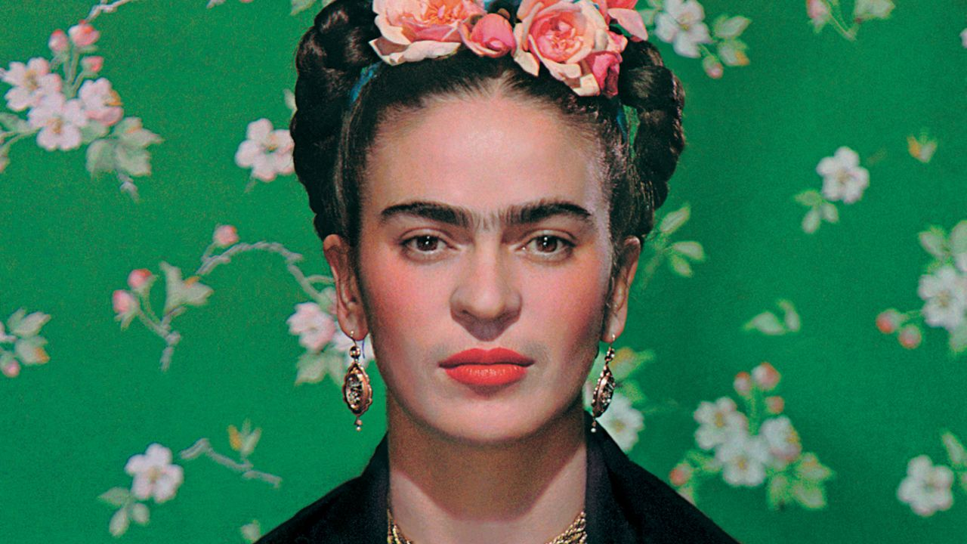
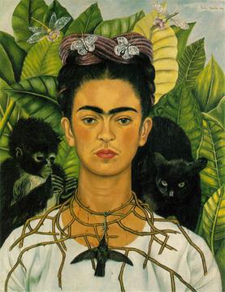
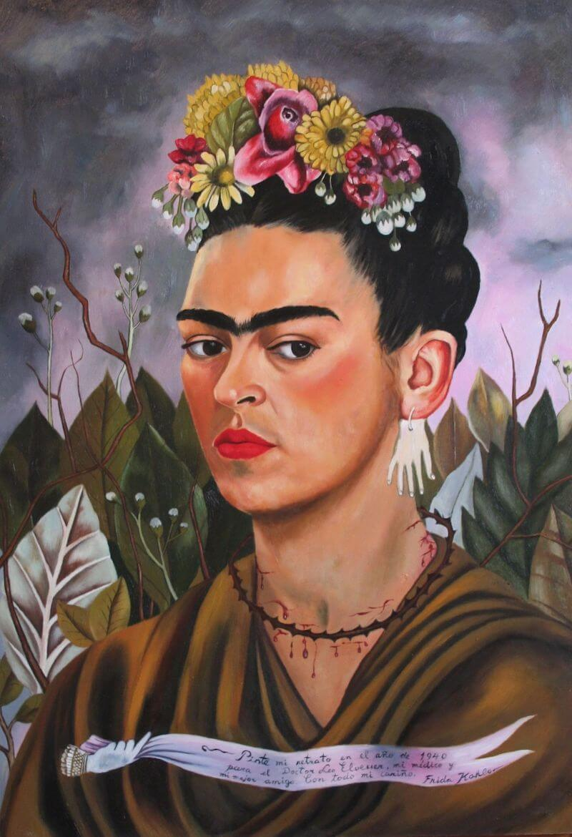
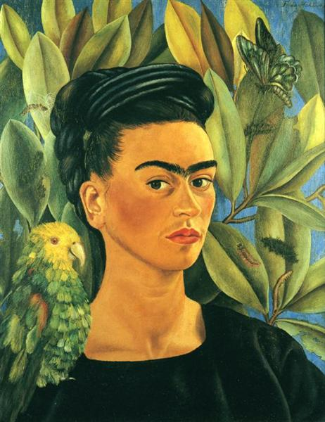
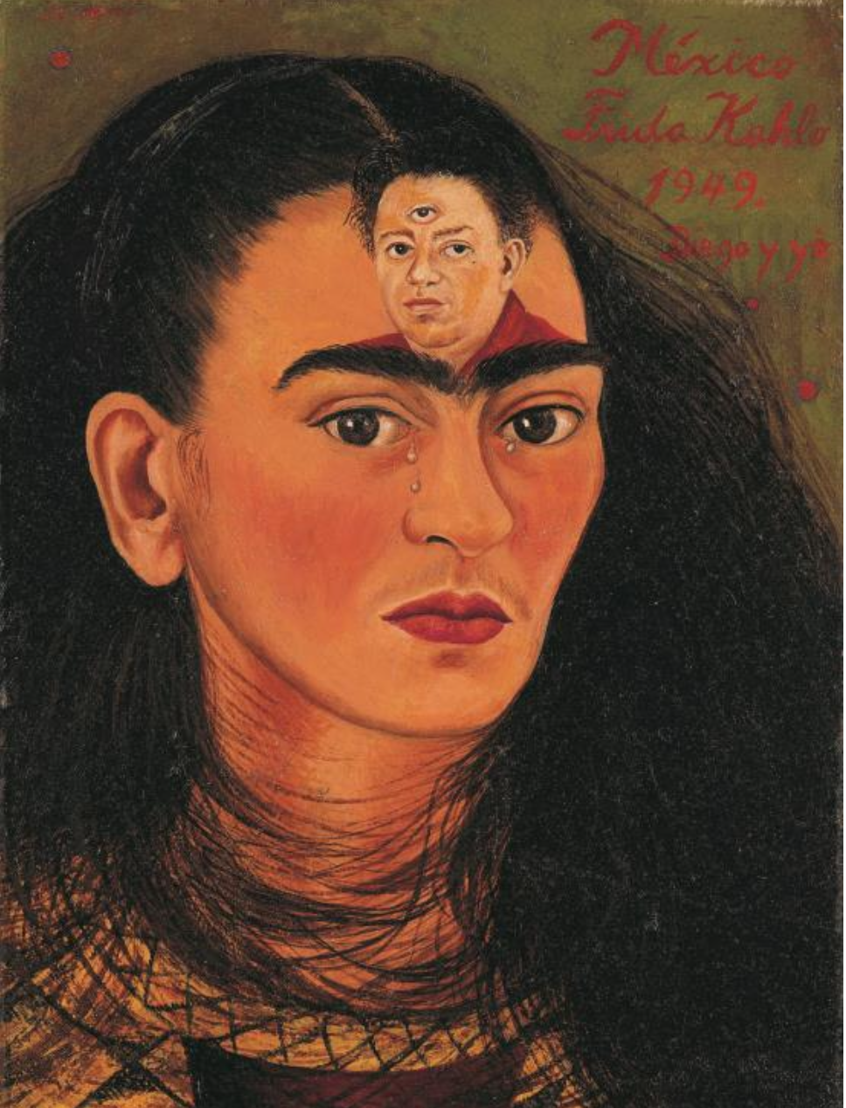
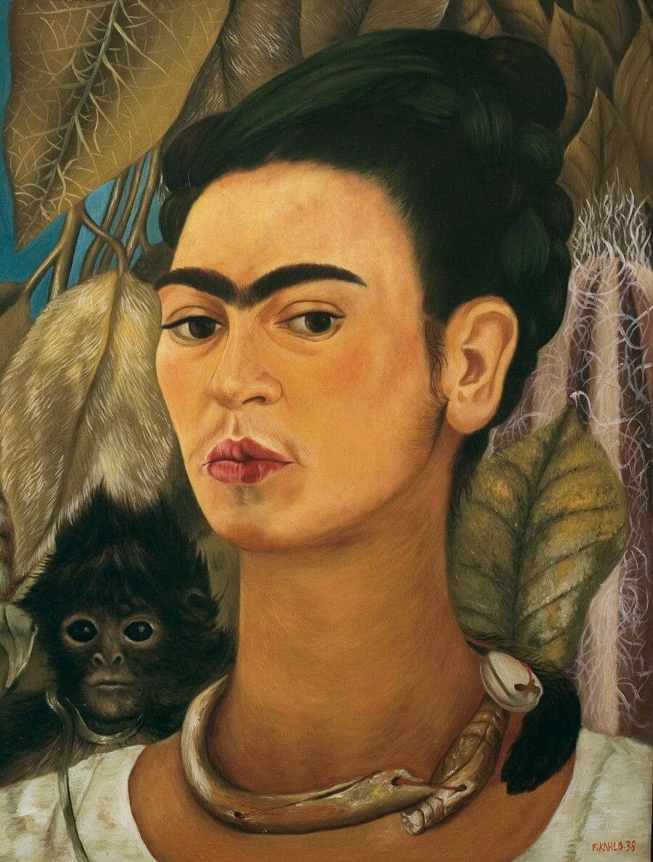
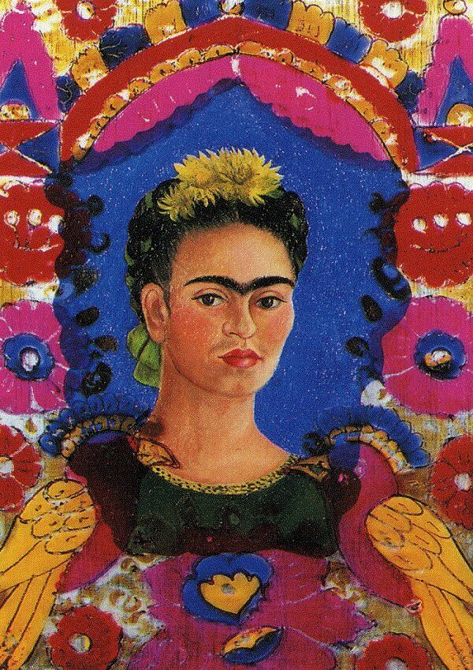
Through Frida’s Eyes:
Frida Kahlo, Politics,
& the Creative Women
Who Radicalized Mexico
A new biography
in contract, UNC Press
Stephanie J. Smith
Department of History

Slide 6
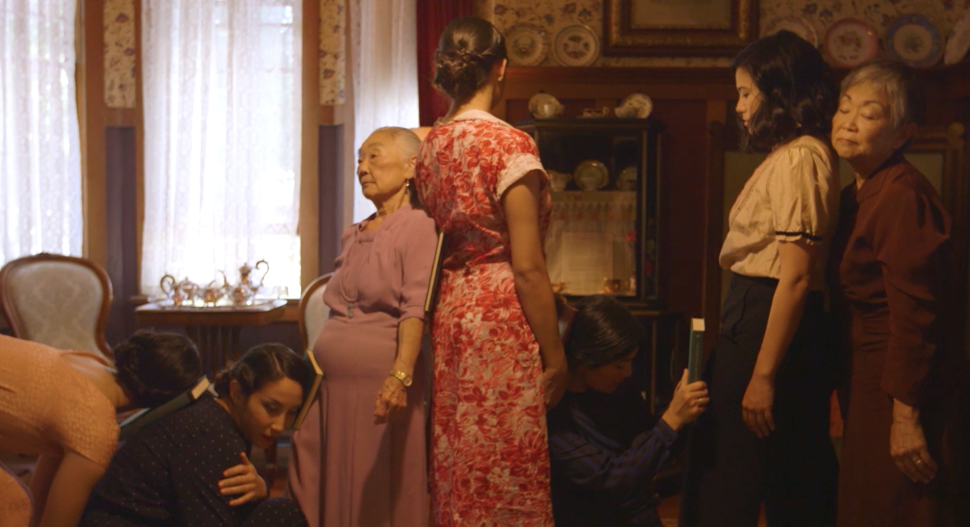
Urgent Animations:
the Afterlives of Japanese Imperialism in Transpacific Contemporary Art
Namiko Kunimoto,
Associate Professor
Director, Center for Ethnic Studies
Ohio State University

Slide 7
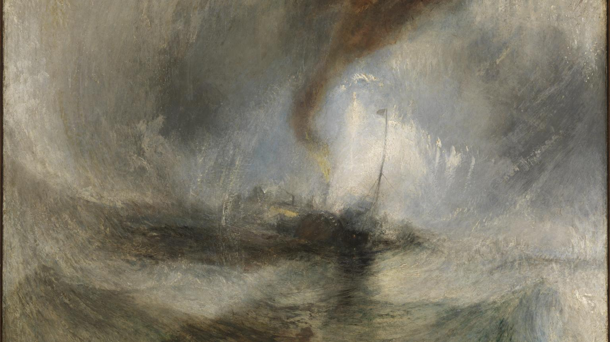

Improbable Powers:
Romanticism and the Industrial Revolution
Jacob Risinger
English

Slide 8
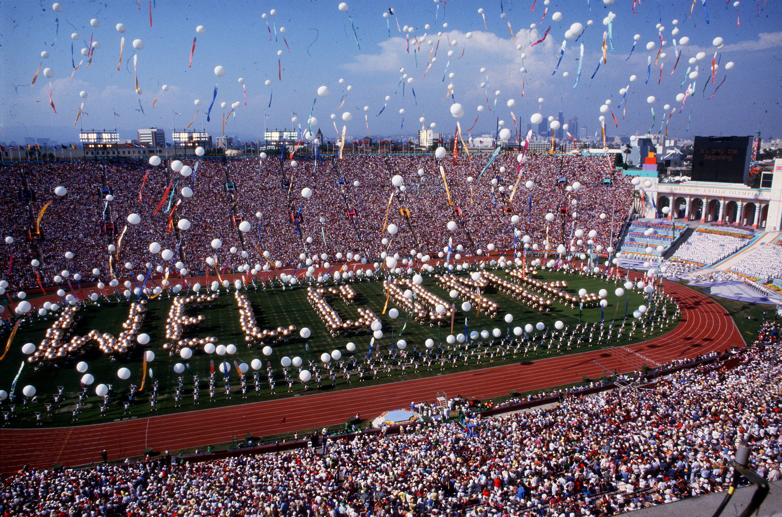
The Los Angeles 1984 Olympics: Using a Logic Model as a tool to understand soft power
Visual Inquiry: Learning & Teaching Art
Tiffany Bourgeois
Department of Arts Administration, Education and Policy
Photo credit: Ken Hively

Slide 9
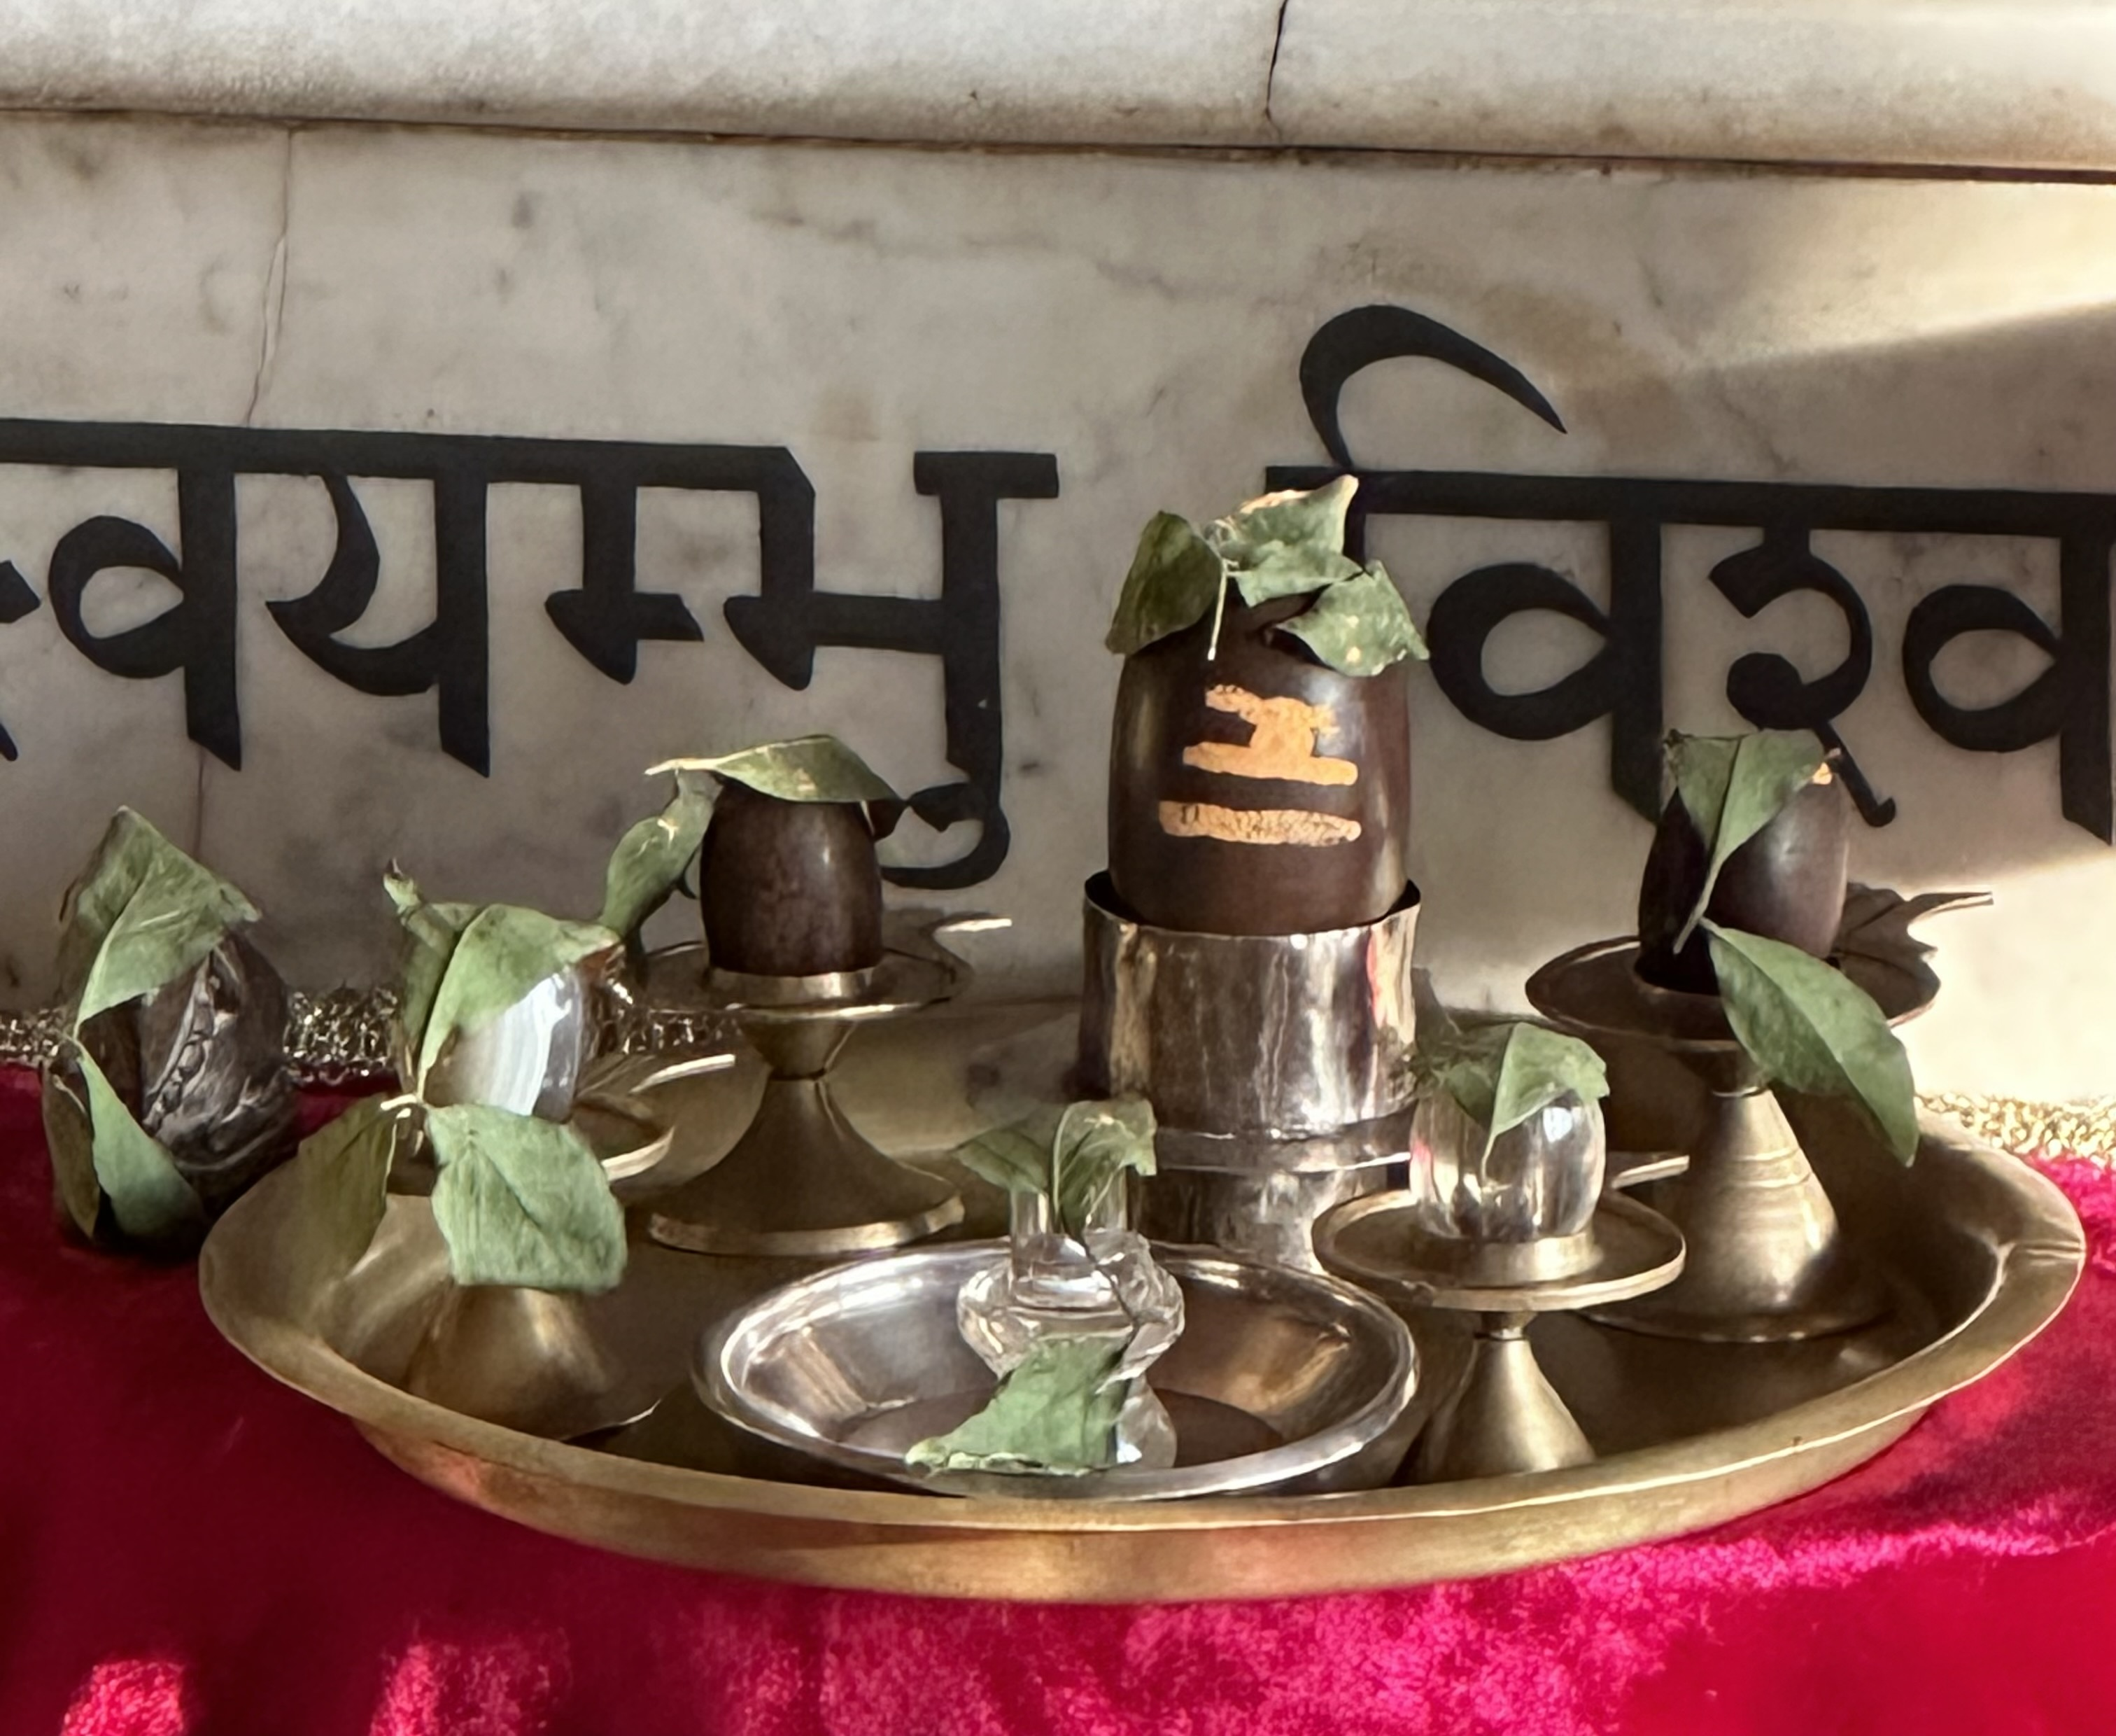
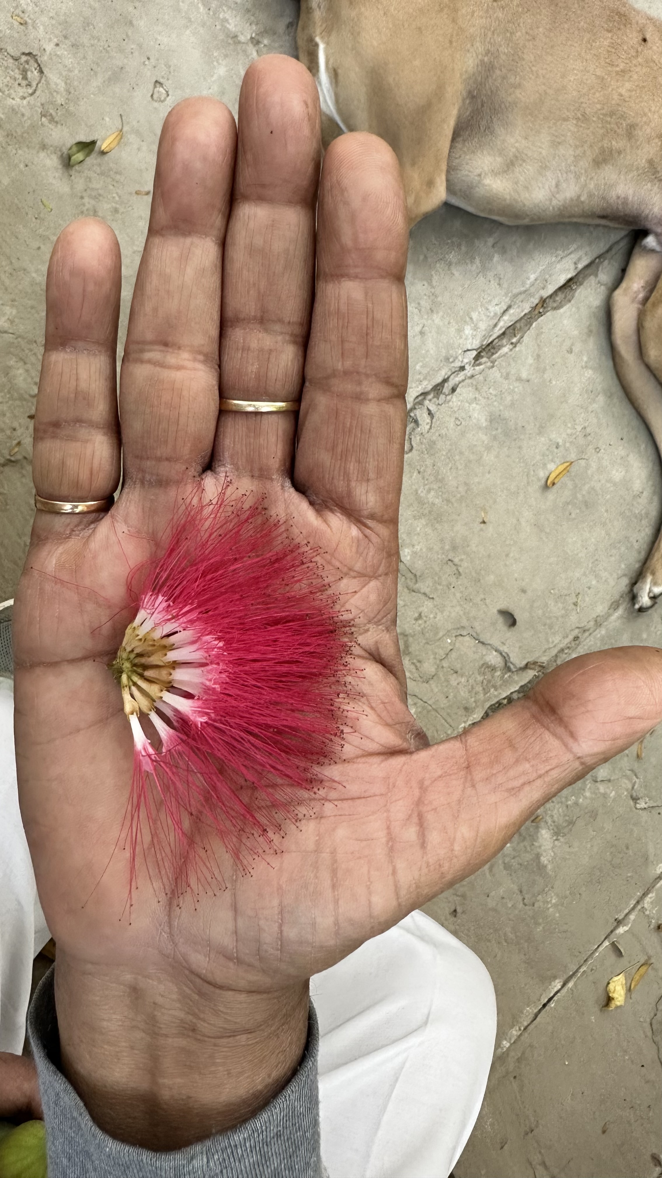
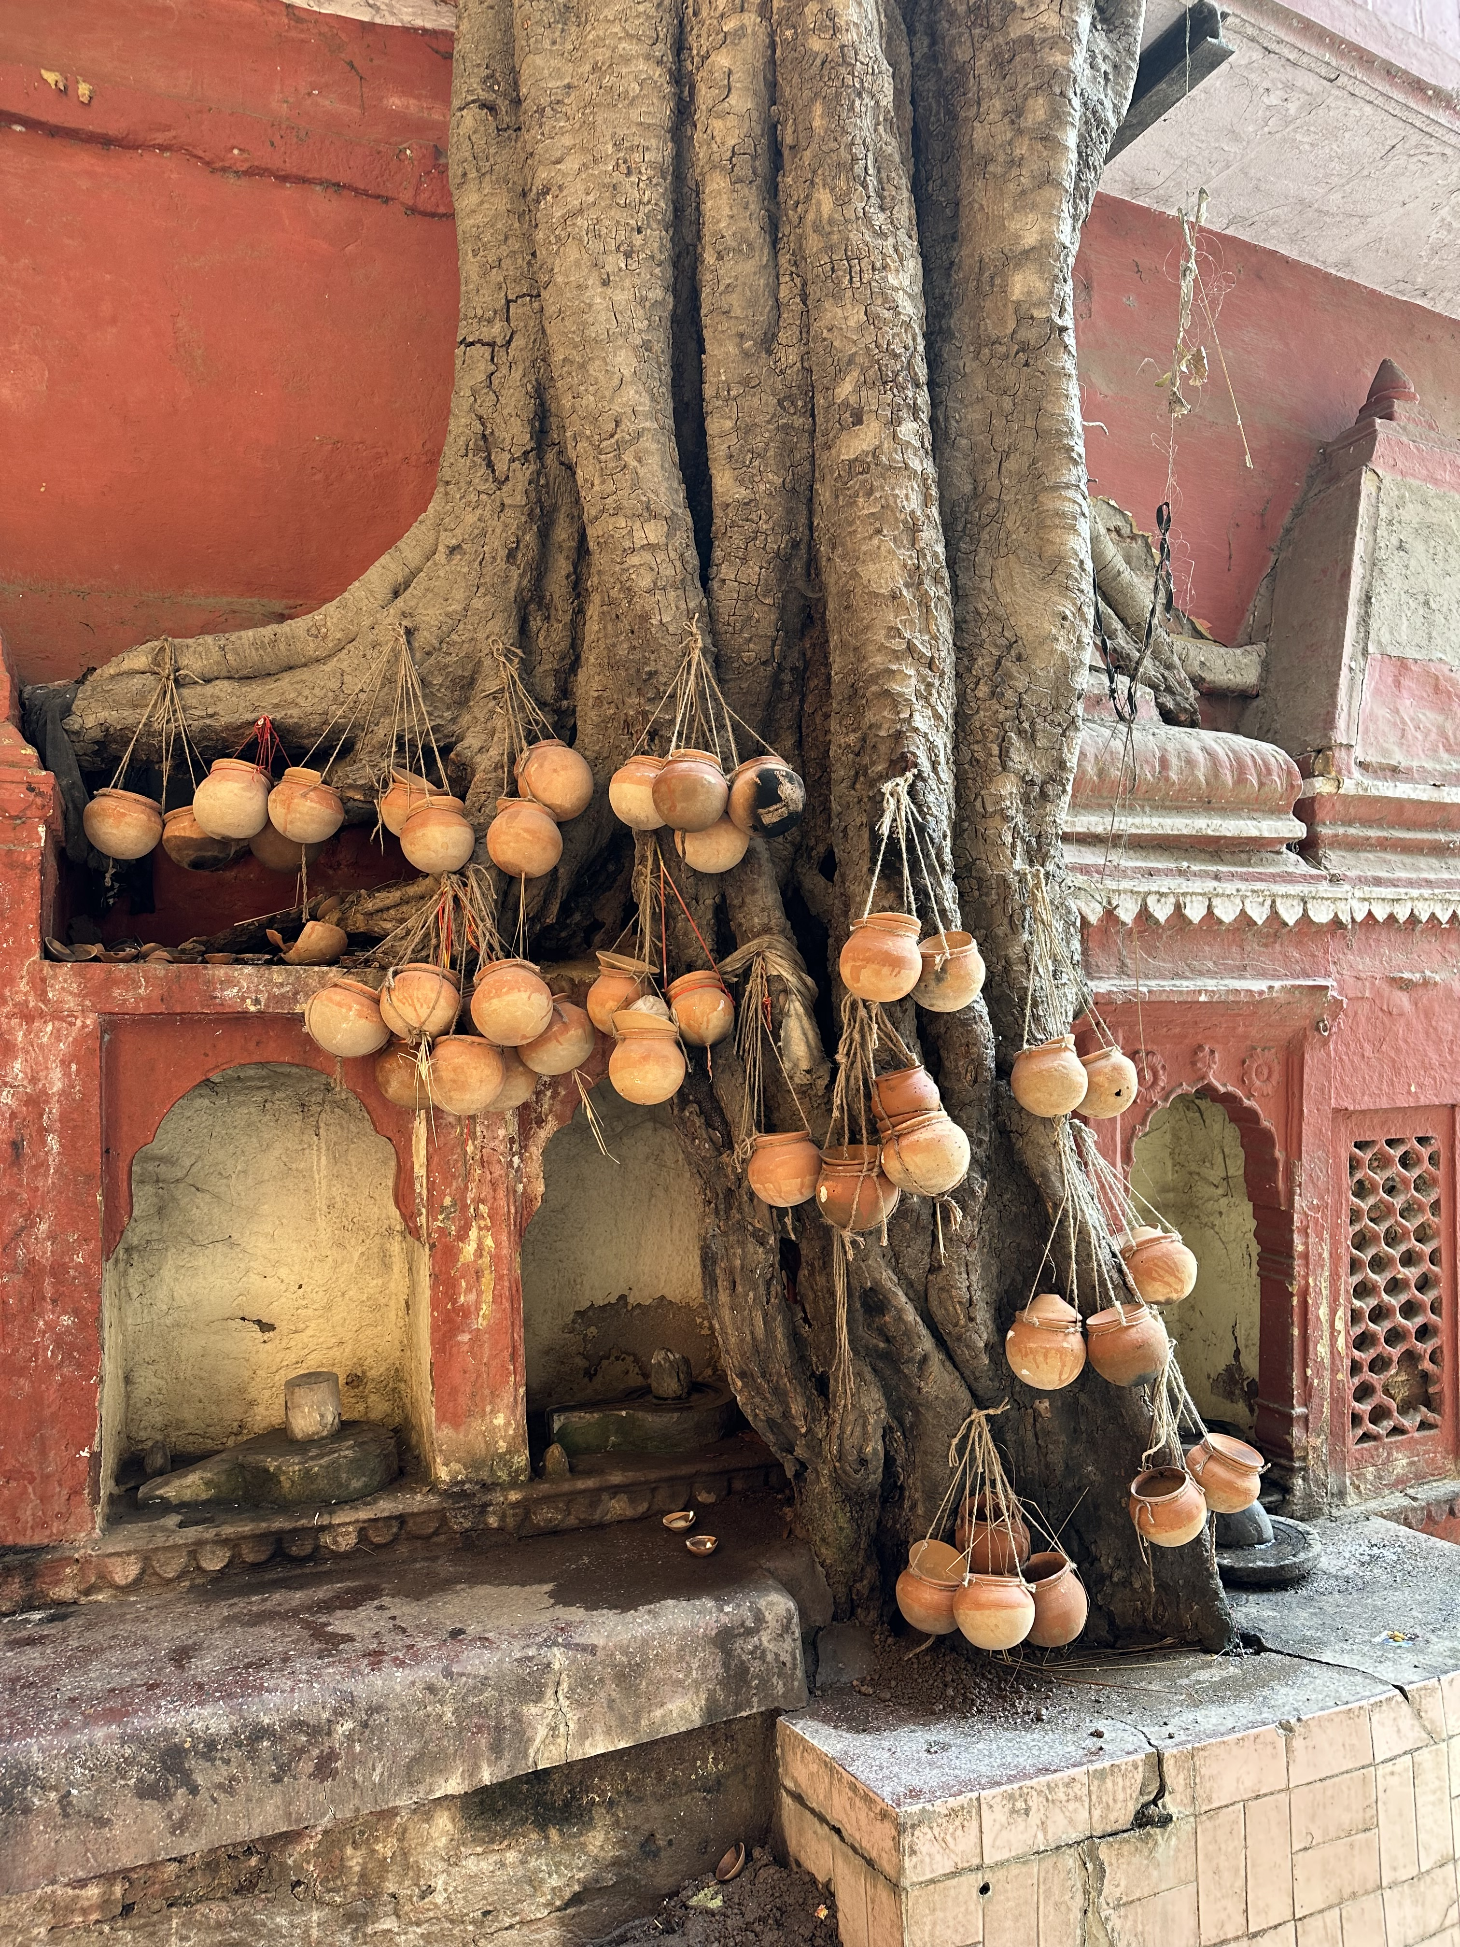
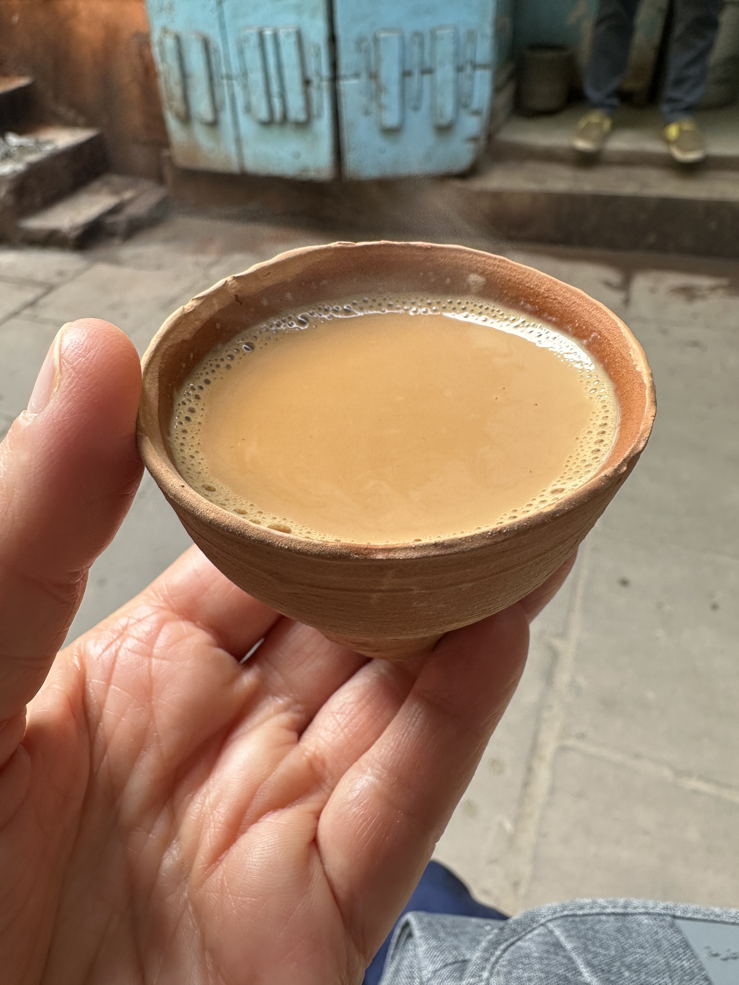
Alison Crocetta
Associate Professor
Department of Art
Artist in Residence at Kriti Gallery in Varanasi, India &
Open Channel Reiki

Slide 10
Theorizing Reception: Antoinette Brown Blackwell’s Response to Evolutionary Theory
Carolyn Skinner
Department of English
OSU Newark
“Theorizing Reception” asserts that Antoinette Brown Blackwell’s The Sexes Throughout Nature (1875) not only responded to nineteenth-century evolutionary theory, but also theorized reception as a rhetorical practice especially suited to women, one that
  Offered women a means of intervening in powerful discourses
  Presented opportunities to incorporate women’s experiences and perspectives into scientific knowledge-making
  Risked reinforcing the belief that women were not capable of original research

Slide 11

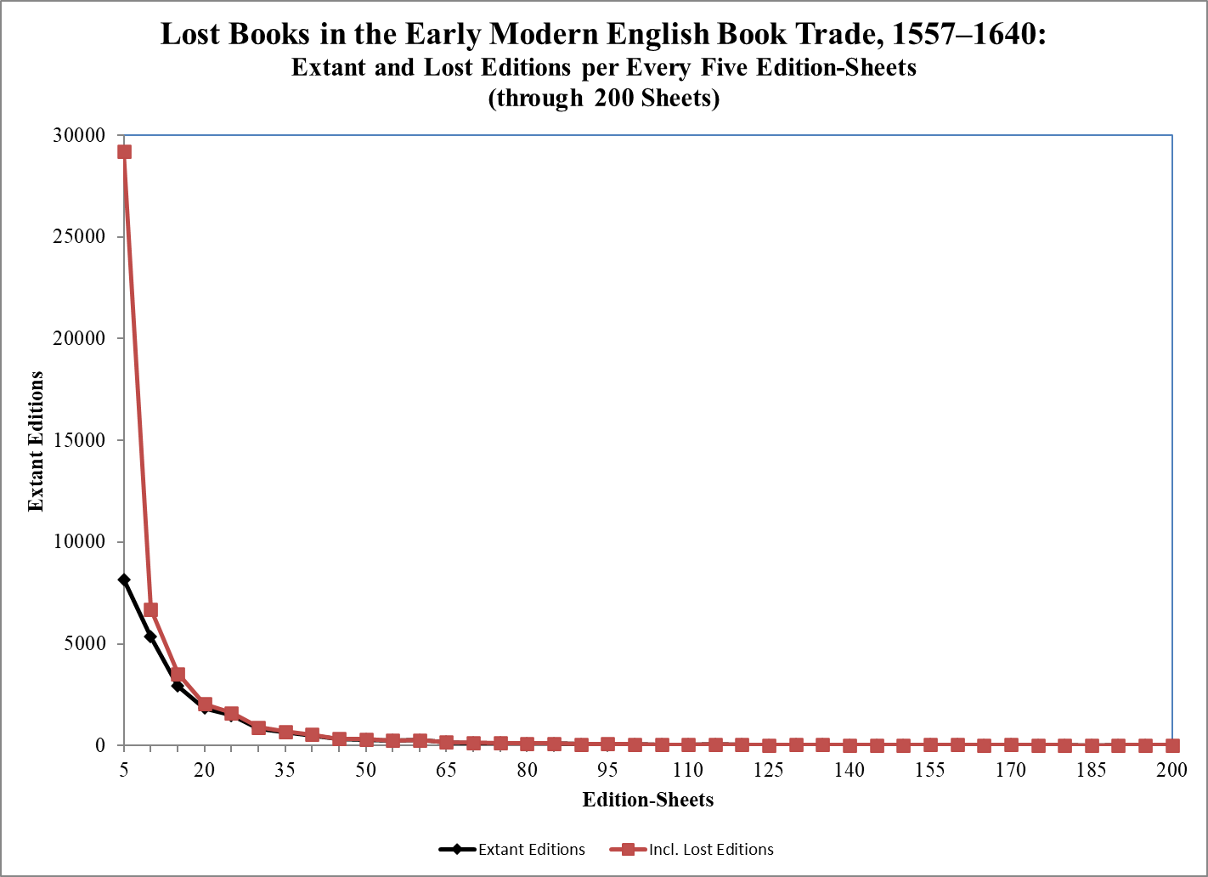
Lost Books:
The Dark Matter of the Early Modern English Book Trade
Alan B. Farmer
English Department
Ohio State University
farmer.109@osu.edu

Slide 12

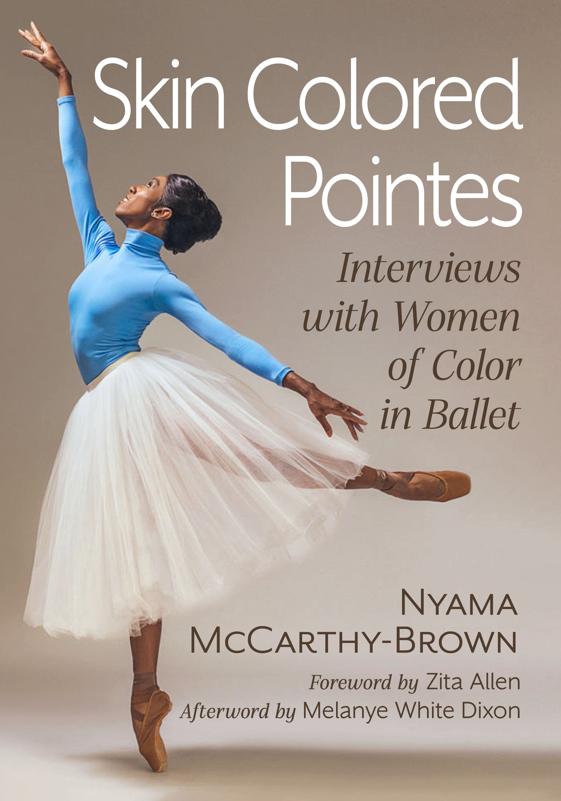
Nyama McCarthy-Brown, Department of Dance
I was able to complete this book manuscript through the support of the A&H Course Release Program. The expected release date for the book is early spring on 2024.

